Slide 1

SDP hierarchies and quantum states
Aram Harrow (MIT)
Simons Institute 2014.1.17

Slide 2
a theorem
Let M2R₊^{m£n}.
Say that a set S⊆[n]^{k} is δ-good if ∃φ:[m]^{k} → S
such that ∀(j_{1,} …, j_{k})∈S,
f(k,δ):= max{ |S| : ∃S⊆[n]^{k}, S is δ-good}
Then

Slide 3
a theorem
The capacity of a noisy channel equals the maximum over input distributions of the mutual information between input and output.
[Shannon ’49]

Slide 4
2->4 norm
Define ||x||_{p} := (𝔼_{i} |x_{i}|^{p})^{1/p}
Let A2R^{m£n}.
||A||_{2!4} := max { ||Ax||₄ : ||x||₂ = 1}
How hard is it to estimate this?
optimization problem over a degree-4 polynomial

Slide 5
SDP relaxation for 2->4 norm
where
L is a linear map from deg ≤k polys to R
L[1] = 1
L[p(x) (𝔼_{i} x_{i}² – 1)] = 0 if p(x) has degree ≤ k-2
L[p(x)²] ≥ 0 if p(x) has degree ≤ k/2
Converges to correct answer as k→∞. [Parrilo ’00, Lasserre ‘01]
Runs in time n^{O(k)}

Slide 6
Why is this an SDP?
Constraint: L[p(x)²] ≥ 0 whenever deg(p) ≤ k/2
p(x) = ∑_{α} p_{α} x^{α}
α= (α₁ , …, α_{n})
α_{i} ≥ 0
∑_{i}α_{i} ≤ k/2
L[p(x)²] = ∑_{α,β} L[x^{α+β}] p_{α} p_{β}
≥0 for all p(x) iff
M is positive semi-definite (PSD),
where M_{α,β} = L[x^{α+β}]

Slide 7

Why care about 2->4 norm?
Unique Games (UG):
Given a system of linear equations: x_{i} – x_{j} = a_{ij} mod k.
Determine whether ≥1-² or ≤² fraction are satisfiable.
Small-Set Expansion (SSE):
Is the minimum expansion of a set with ≤±n vertices ≥1-² or ≤²?
UG ≈ SSE ≤ 2->4
G = normalized adjacency matrix
P_{λ} = largest projector s.t. G ≥ ¸P
Theorem:
All sets of volume ≤ ± have expansion ≥ 1 - ¸^{O(1)}
iff
||P_{λ}||_{2->4} ≤ 1/±^{O(1)}

Slide 8
quantum states
Pure states
A quantum (pure) state is a unit vector v∈C^{n}
Given states v∈C^{m} and w∈C^{n}, their joint state is
v⊗w∈C^{mn}, defined as (v⊗w)_{i,j} = v_{i} w_{j}.
u is entangled iff it cannot be written as u = v⊗w.
Density matrices
ρ satisfying ρ≥0, tr[ρ]=1
extreme points are pure states, i.e. vv*.
can have classical correlation and/or quantum entanglement
correlated
entangled

Slide 9
when is a mixed state entangled?
Definition: ρ is separable (i.e. not entangled)
if it can be written as
ρ = ∑_{i} p_{i} v_{i} v_{i}* ⊗ w_{i} w_{i}*
Sep = conv{vv* ⊗ ww*}
probability
distribution
unit vectors
Weak membership problem: Given ρ and the promise that
ρ∈Sep or ρ is far from Sep, determine which is the case.
Optimization: h_{Sep}(M) := max { tr[Mρ] : ρ∈Sep }
Notes:
instead, let’s approach entangled via games

Slide 10
monogamy of entanglement
Physics version: ρ^{ABC} a state on systems ABC
AB entanglement and AC entanglement trade off.
“proof”: If ρ^{AB} is very entangled, then measuring B can
reduce the entropy of A, so ρ^{AC} cannot be very entangled.
Partial trace: ρ^{AB} = tr_{C} ρ^{ABC}
Works for any basis of C. Interpret as different choices
of measurement on C.
Notes:
Monogamy can be thought of as definition of entanglement:
correlations that cannot be shared.

Slide 11
A hierachy of tests for entanglement
Definition: ρ^{AB} is k-extendable if there exists an extension
with for each i.
all quantum states (= 1-extendable)
2-extendable
100-extendable
separable =
∞-extendable
Algorithms: Can search/optimize over k-extendable states in time n^{O(k)}.
Question: How close are k-extendable states to separable states?

Slide 12
2->4 norm ≈ h_{Sep}
A = ∑_{i} e_{i} a_{i}^{T}
M = 𝔼_{i} a_{i} a_{i}^{T} ⊗ a_{i} a_{i}^{T}
Easy direction:
h_{Sep} ≥ 2->4 norm
ρ=xx* ⊗ xx*
Harder direction:
2->4 norm ≥ h_{Sep}
Given an arbitrary M, can we make it look like 𝔼_{i} a_{i}a_{i}* ⊗ a_{i}a_{i}* ?
Answer: yes, using techniques of [H, Montanaro; 1001.0017]

Slide 13

the dream
SSE
2->4
h_{Sep}
hardness
algorithms
…quasipolynomial (=exp(polylog(n)) upper and lower bounds for unique games

Slide 14
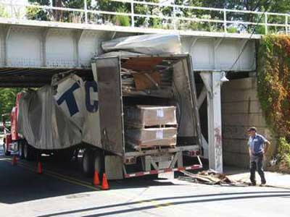
progress so far

Slide 15
SSE hardness??
1. Estimating h_{Sep}(M) ± 0.1 for n-dimensional M is at least
as hard as solving 3-SAT instance of length ≈log²(n).
[H.-Montanaro 1001.0017] [Aaronson-Beigi-Drucker-Fefferman-Shor 0804.0802]
2. The Exponential-Time Hypothesis (ETH) implies a lower
bound of Ω(n^{log(n)}) for h_{Sep}(M).
3. ∴ lower bound of Ω(n^{log(n)}) for estimating ||A||_{2->4} for
some family of projectors A.
4. These A might not be P_{≥λ} for any graph G.
5. (Still, first proof of hardness for
constant-factor approximation of ||¢||_{2→4}).

Slide 16
positive results about hierarchies: 1. use dual
Primal: max L[f(x)] over L such that
L is a linear map from deg ≤k polys to R
L[1] = 1
L[p(x) (∑_{i} x_{i}² – 1)] = 0
L[p(x)²] ≥ 0
Dual: min λ such that
f(x) + p(x) (𝔼_{i} x_{i}² – 1) + ∑_{i} q_{i}(x)² = λ
for some polynomials p(x), {q_{i}(x)} s.t. all degrees are ≤ k.
Interpretation: “Prove that f(x) is ≤ λ using only the
facts that 𝔼_{i} x_{i}² – 1 = 0 and sum of square (SOS)
polynomials are ≥0. Use only terms of degree ≤k. ”
“Positivestellensatz” [Stengel ’74]

Slide 17
SoS proof example
z²≤z $ 0≤z≤1
Axiom: z² ≤ z
Derive: z ≤ 1
1 – z = z – z² + (1-z)²
≥ z – z²
(non-negativity of squares)
≥ 0
(axiom)

Slide 18
SoS proof of hypercontractivity
Hypercontractive inequality:
Let f:{0,1}^{n}R be a polynomial of degree ≤d. Then
||f||₄ ≤ 9^{d/4} ||f||₂.
equivalently:
||P_{d}||_{2->4} ≤ 9^{d/4} where P_{d} projects onto deg ≤d polys.
Proof:
uses induction on n and Cauchy-Schwarz.
Only inequality is q(x)² ≥ 0.
Implication: SDP returns answer ≤9^{d/4} on input P_{d.}

Slide 19
SoS proofs of UG soundness
[BBHKSZ ‘12]
Result: Degree-8 SoS relaxation refutes UG instances
based on long-code and short-code graphs
Proof: Rewrite previous soundness proofs as SoS proofs.
Ingredients:
1. Cauchy-Schwarz / Hölder
2. Hypercontractive inequality
3. Influence decoding
4. Independent rounding
5. Invariance principle
UG Integrality Gap:
Feasible SDP solution
SoS upper bound
Upper bound to actual solutions
actual solutions

Slide 20
positive results about hierarchies: 2. use q. info
Idea:
Monogamy relations for entanglement imply performance
bounds on the SoS relaxation.
[Brandão-Christandl-Yard ’10] [Brandão-H. ‘12]
Proof sketch:
ρis k-extendable, lives on AB₁ … B_{k}.
M can be implemented by measuring Bob, then Alice. (1-LOCC)
Let measurement outcomes be X,Y₁,…,Y_{k}.
Then
log(n) ≥ I(X:Y₁…Y_{k}) = I(X:Y₁) + I(X:Y₂|Y₁) + … + I(X:Y_{k}|Y₁…Y_{k-1})
…algebra…
h_{Sep}(M) ≤ h_{k-ext}(M) ≤ h_{Sep}(M) + c(log(n) / k)^{1/2}

Slide 21
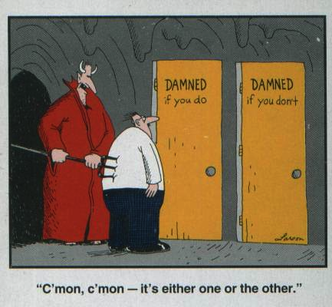
Alternate perspective
For i=1,…,k
  Measure B_{i}.
  If entropy of A doesn’t change, then A:B_{i} are ≈product.
  If entropy of A decreases, then condition on B_{i}.

Slide 22
the dream: quantum proofs for classical algorithms
Information-theory proofs of de Finetti/monogamy,
e.g. [Brandão-Christandl-Yard, 1010.1750] [Brandão-H., 1210.6367]
h_{Sep}(M) ≤ h_{k-Ext}(M) ≤ h_{Sep}(M) + (log(n) / k)^{1/2} ||M||
if M∈1-LOCC
M = ∑_{i} a_{i}a_{i}* ­ a_{i}a_{i}* is ∝ 1-LOCC.
Constant-factor approximation in time n^{O(log(n))}?
Problem: ||M|| can be ≫ h_{Sep}(M). Need multiplicative approximaton or we lose dim factors.
Still yields subexponential-time algorithm.

Slide 23
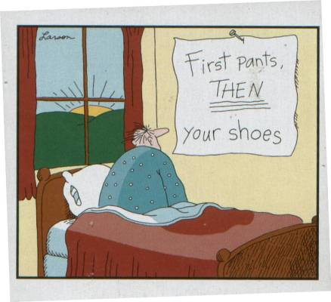
SDPs in quantum information
Goal: approximate Sep
Relaxation: k-extendable + PPT
Goal: λ_{min} for Hamiltonian on n qudits
Relaxation: L : k-local observables → R
such that L[X†X] ≥ 0 for all k/2-local X.
Goal: entangled value of multiplayer games
Relaxation: L : products of ≤k operators → R
such that L[p†p] ≥ 0 ∀noncommutative poly p of degree ≤ k,
and operators on different parties commute.
Non-commutative positivstellensatz [Helton-McCullough ‘04]
relation between these? tools to analyze?

Slide 24
questions
We are developing some vocabulary for understanding
these hierarchies (SoS proofs, quantum entropy, etc.).
Are these the right terms?
Are they on the way to the right terms?
Unique games, small-set expansion, etc:
quasipolynomial hardness and/or algorithms
Relation of different SDPs for quantum states.
More tools to analyze #2 and #3.

Slide 25
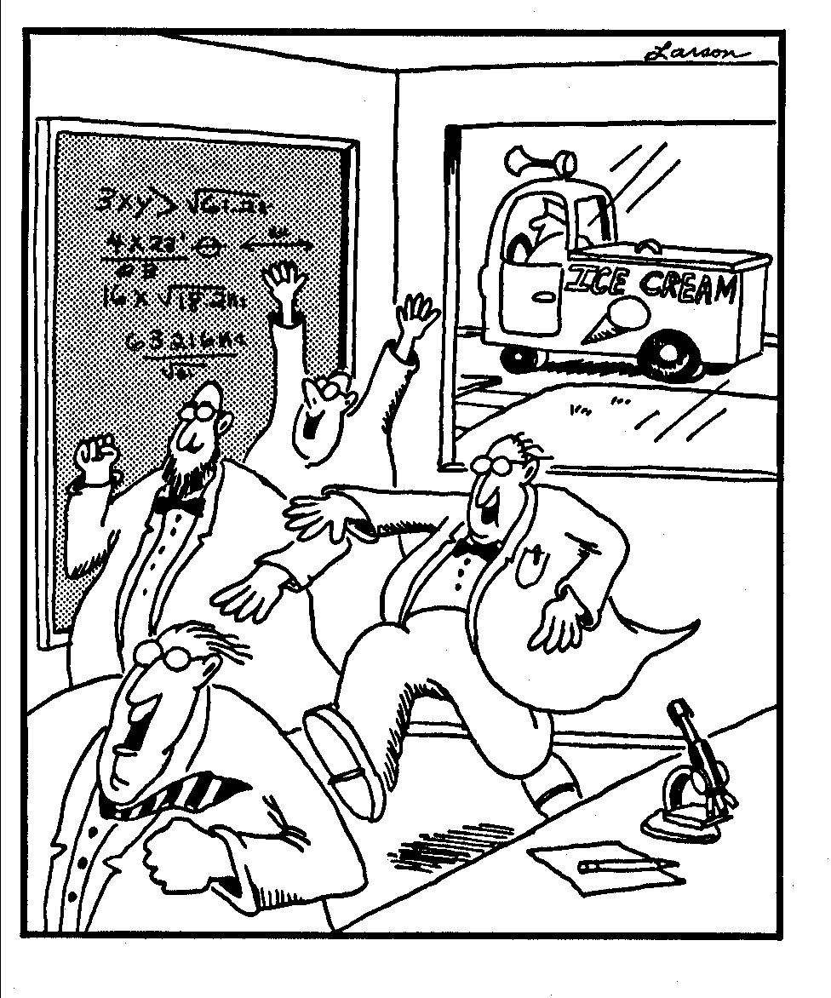

Slide 26
Why is this an SDP?

