Slide 1
Thin-Film Design Refinement Via Efficient Parallel Combinatorial Search
Jonathan R. Birge
OIC 2016
Notes:
1
1

Slide 2
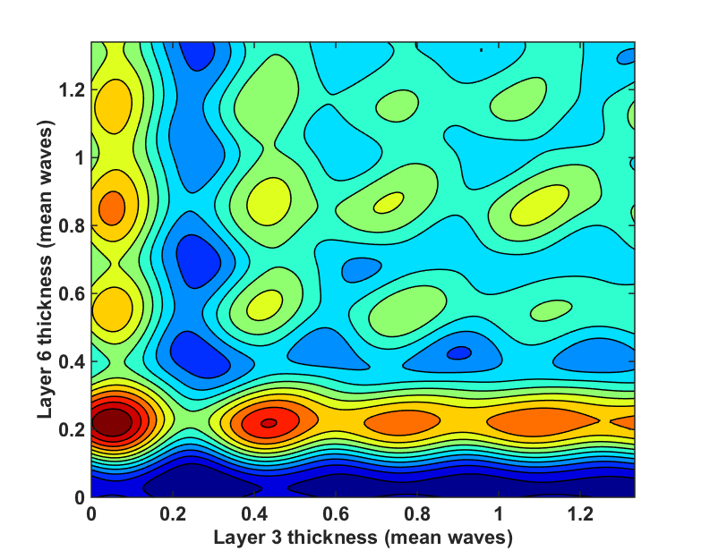
Thin Film Merit Function Structure
• 14 layer AR coating on 1.52 substrate • Uniform thin layer initial conditions • low index: 1.35, high index: 2.35
Merit function of AR coating versus two layer thicknesses
Local minima tend to be spaced quasi-uniformly by ¼- to ½-wave of mean optical thickness
Notes:
Most thin film design approaches involve refinement one or more refinement steps, usually accomplished via gradient descent techniques. Thin film refinement is prone to getting stuck in local minima, and one reason is that there are a lot of them. Because they rely on wave interference phenomena, it’s not surprising that the merit functions of thin film filters tend to be quasi periodic. For example…

Slide 3
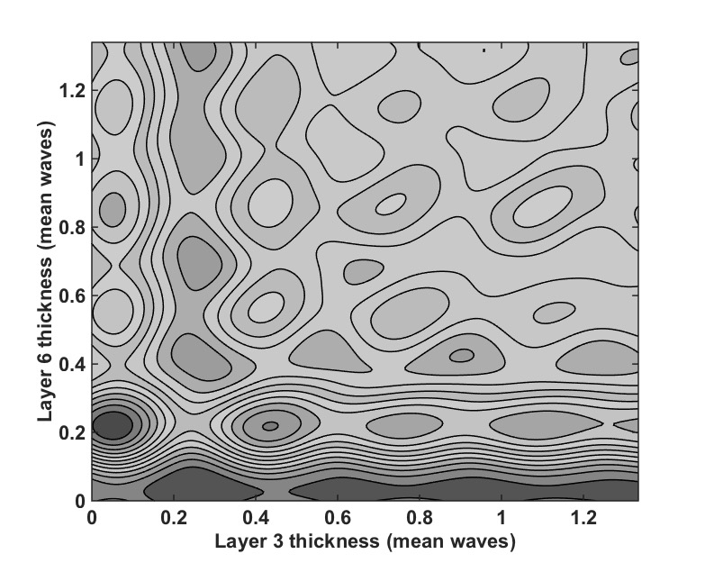
Combinatorial Search Concept
• 14 layer AR coating on 1.52 substrate • Uniform thin layer initial conditions • low index: 1.35, high index: 2.35
Merit function of AR coating versus two layer thicknesses
• Notional start point
• k = 2 neighborhood
Searching for better local minima can be done by simultaneously perturbing groups of k layers by enough to escape local minima and reoptimizing
Notes:
Given the recent availability of cheap grid computing utilities, such as Amazon EC2, an obvious approach is to just do a big search in parallel around a local minima, to see if something better is nearby. And that’s the simple approach we’ve taken here. We take groups of layers and try every possible combination of adding or subtracting an optical thickness estimated to match the periodicity of the design merit function. Akin to particle swarm techniques, except the particle swarm locations are deterministic and chosen to coincide with the inherent structure of the thin film merit function. We don’t expect this method to converge to better solutiions than other global optimization approaches, in fact we probably won’t. The only reason for the approach we’re taking is that it’s extremely efficient to implement in parallel and should scale to the massive numbers of compute nodes that are possible with modern grid computing utilities.

Slide 4
Parallelization Approach
Initialization
Asynchronous Scheduling
Worker
Node
Worker
Node
(i,j,k,l)
Worker
Node
Worker
Node
Master
Node
Master
Node
F
•••
•••
Stack material data
Starting position
Merit function
Worker
Node
Out: Indices to jump
Back: Refined merit function from new start points
Worker
Node
Dynamic computation assignment prioritizes uniform node utilization over communication efficiency in the face of unpredictable computation times
Notes:
We’ve implemented this algorithm in parallel on Lincolns computing cluster. The reason this approach should be very scalable is that it’s completely deterministic, and so it requires very little communication between compute nodes. There’s a bit of overhead at the beginning as the design parameters are distributed to all compute nodes. After that, however, the master node just tells each node which layers to perturb and in which directly, and as each node finishes reoptimizing it sends back the single merit function value. We do this asyncronously, because each reoptimization takes a different amount of time. So, it’s embarrassingly parallel, as they say, but not trivially parallel.

Slide 5
Implementation Efficiency
Computation time scales linearly with processor count
Parallel algorithm is not communication-limited
Notes:
We’ve tested how it works out to 256 nodes, and it scales linearly. We expect it should scale well to thousands of nodes, especially for complex designs.

Slide 6
AR Coating Design Example
• 18 layer AR coating on 1.52 substrate • Low index: 1.38, high index: 2.35 • Trivial start point: uniform 1/20th mean wave layers • k = 2
Reflectivity
R_{av} = 0.16%
R_{av} = 0.063%
Wavelength (um)
*Following Dobrowolski et al, “Optimal single-band normal-incidence antireflection coatings”, Optics Letters 35 (1996)
Notes:
While this algorithm isn’t intended to be used on its own, but as part of a bigger design technique, we did try using it alone with a trivial set of starting layers to design AR coatings, as an initial test.
Here’s an example with 14 layers, and you can see it came up with a pretty good solution without getting stuck in a bad local minimum, as you’d expect from such a poor starting point. (And we verified that without the combinatorial search, it did.)
Would be nice to show initial and final stacks, here, as well as local optimum found if global search isn’t done…

Slide 7
AR Coating Design Results
• 14 layer AR coating on 1.52 substrate • Low index: 1.38, high index: 2.35 • k = 4 search space
Combinatorial opt. from trivial start point
Antireflection coating literature*
R_{av} = 0.072%
R_{av} = 0.085%
N = 14
R_{av} = 0.052%
R_{av} = 0.060%
Reflectivity
N = 20
R_{av} = 0.045%
R_{av} = 0.047%
N = 26
Wavelength (um)
Wavelength (um)
*J. A. Dobrowolski et al, “Optimal single-band normal-incidence antireflection coatings”, Optics Letters 35 (1996)
Notes:
Trying with several different numbers of layers, our approach was consistently able to find AR coatings directly that were competitive with designs from the literature.

Slide 8
Future Work
Test on other design genres
  Initial work on stop/pass-band shows promise, albeit not as dramatic as AR coating
Integrate into larger optimization schemes (e.g. gradual refinement, needle optimization, etc.)
Adaptive jump size determination
Implement on commodity cloud hardware (e.g. Amazon EC2)
Integrate with manufacturing tolerance merit functions
Notes:
This was really just a proof of concept on one design type. We’ve started to look at others, and it appears the method works well, though, with results that aren’t as dramatic as the AR coating. The next obvious step is to try this as the refinement approach in some of the standard design techniques like gradual refinement or needle optimization and see if it shows any improvement.

