Slide 1
MIT 3.071 Amorphous Materials 2: Classes of Amorphous Materials
Juejun (JJ) Hu
hujuejun@mit.edu

Slide 2
After-class reading list
Fundamentals of Inorganic Glasses
Ch. 1 & 5
Introduction to Glass Science and Technology
Ch. 5

Slide 3
Network formers, modifiers and intermediates
Glass network formers
Form the interconnected backbone glass network
Glass network modifiers
Present as ions to alter the glass network
Compensated by non-bridging oxygen (NBO) in oxide glasses
Usually reduce glass network connectivity
Intermediates
Can function as network formers or modifiers depending on glass composition

Slide 4
Network formers, modifiers and intermediates
O
O
+
→
O
Si
O
Si
O
Na₂O
O
O
Bridging oxygen
O
O
Silicon:
glass former
Sodium:
network modifier
O
Si
O⁻ Na⁺
Na⁺ O⁻
Si
O
O
Non-bridging oxygen
O

Slide 5
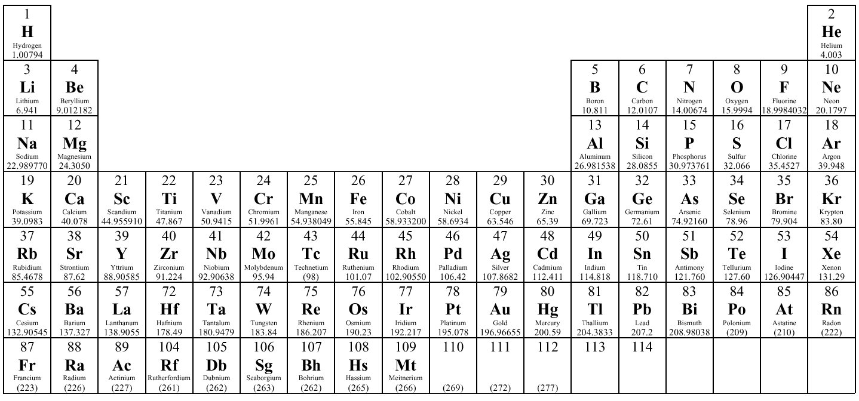
Glass former: high valence state, covalent bonding with O
Modifier: low valence state, ionic bonding with O
Network modifiers
Glass formers
Intermediates

Slide 6
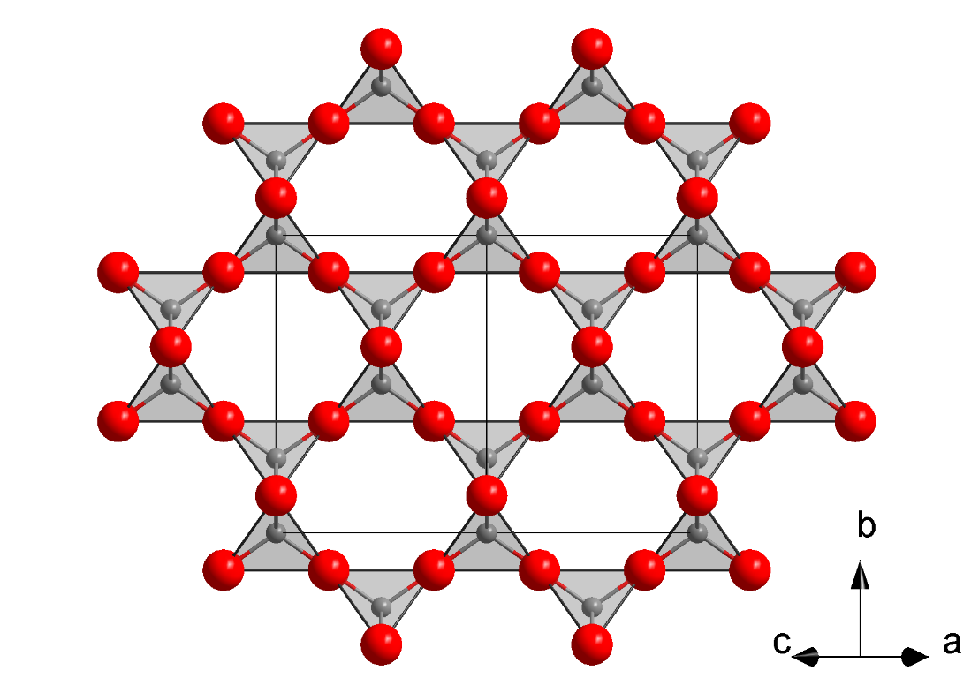
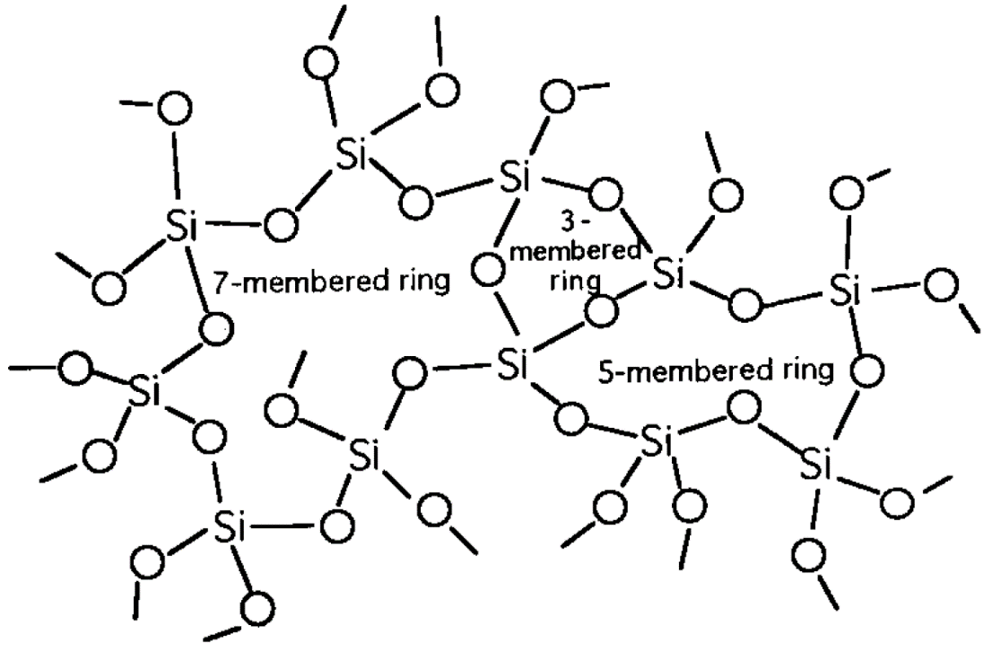
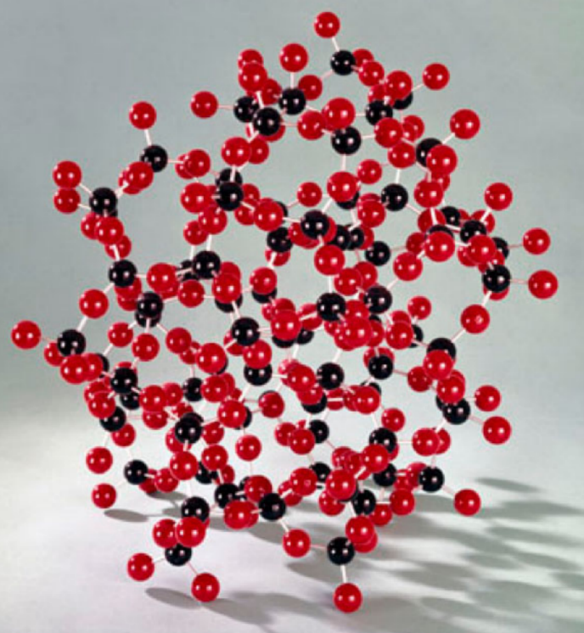
Silica glass (SiO₂)
A 3-D glass network predominantly consisting of corner-sharing SiO₄ tetrahedra interconnected by bridging oxygen (BO)
High network connectivity: high softening point, low diffusion coefficient, small coefficient of thermal expansion (CTE)
Cristobalite

Slide 7
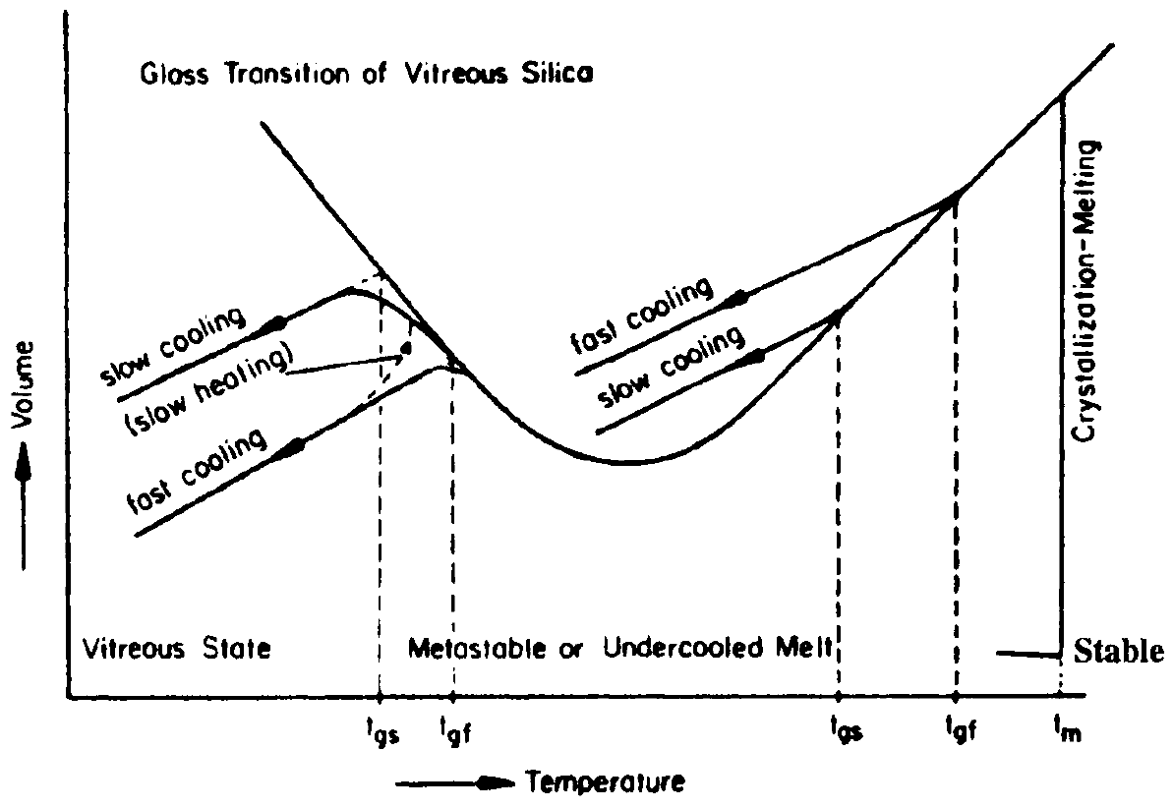
Volume anomaly in silica glass

Slide 8
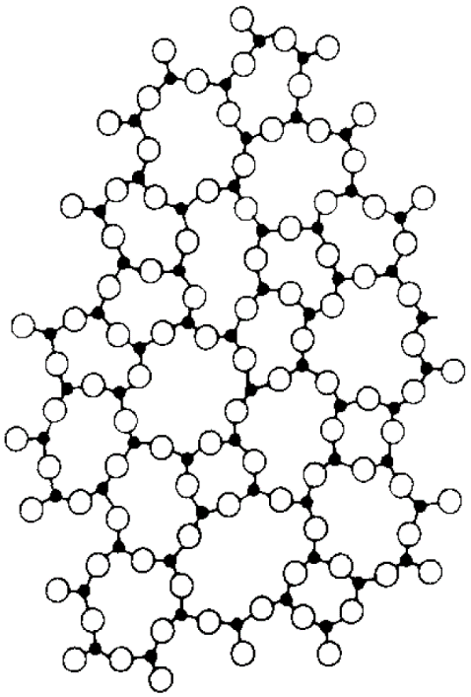
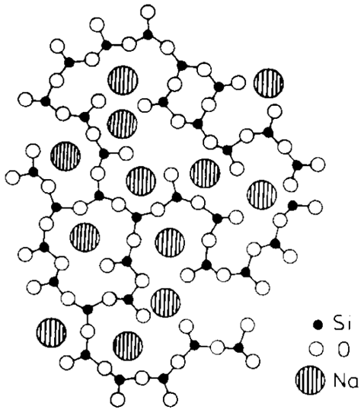
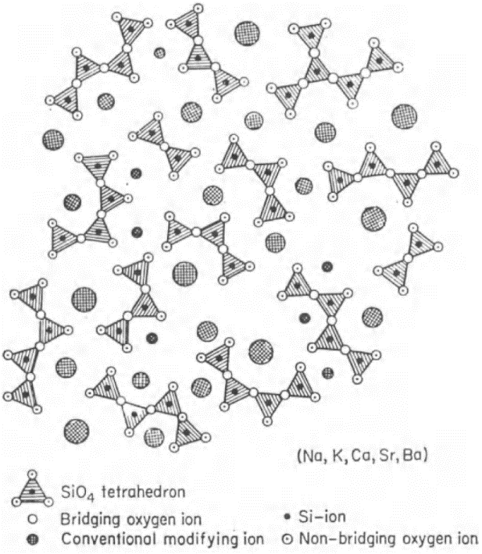
Alkali silicate glass
Each alkali ion creates one non-bridging oxygen
Reduced network connectivity: viscosity decreases (compared to silica at the same T), diffusion coefficient and CTE increases
Increased ionic conductivity, reduced chemical resistance
Invert glass
Increasing alkali concentration
Notes:
How to Prevent Glass Corrosion: http://www.vitroglazings.com/VitroGlazings/media/sitedocuments/TDs/19_TD105F.pdf
H2O + SiONa -> SiOH + NaOH, and the resulting basic solution further expedites glass corrosion
Fire polish process to enhance surface chemical durability of alkali silicate glass
Reduced softening temperature means that these glasses can be recycled

Slide 9
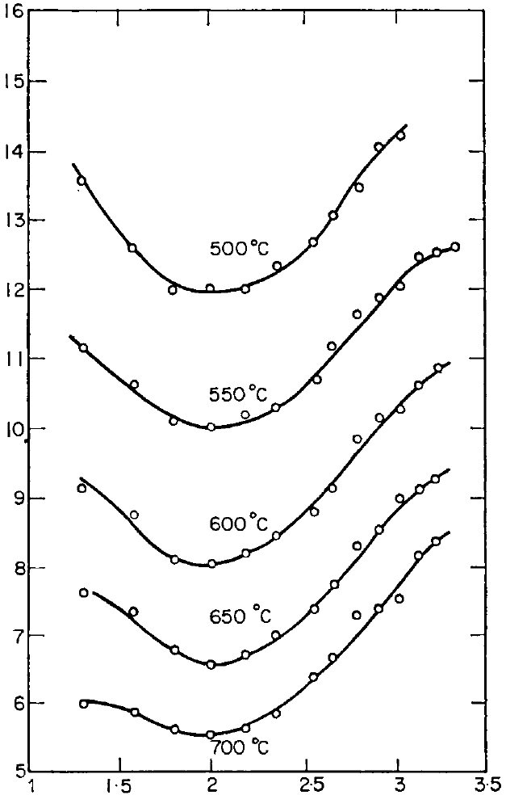
Structural determination in alkali silicate glass
Y : the average number of corners shared per SiO₄ tetrahedron
In a glass with molar composition: x Na₂O · (1-x) SiO₂
Number of NBO per mole: 2x
Number of BO per mole: 2-3x
Number of corners shared per mole: (2-3x) × 2 = 4-6x
Number of tetrahedra per mole: 1-x
Y = (4-6x) / (1-x)
Onset of inverted glass structure: Y = 2, x = 0.5
Viscosity isotherms
Y = 2
log₁₀(viscosity)
Y

Slide 10
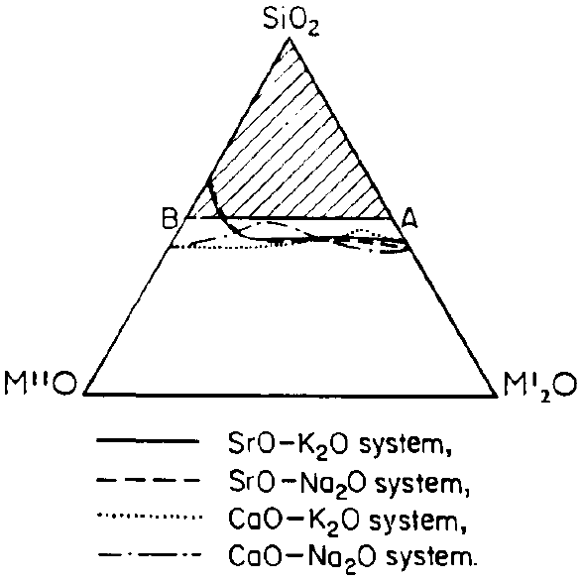
Alkali-alkaline earth-silicate glass
Each alkaline earth ion creates two NBOs
Increased network connectivity compared to alkali silicates: stabilized glass network, improved chemical resistance
Approximate composition of commercial soda-lime glass (window glass):
16Na₂O·10CaO·74SiO₂
+
→
Si
O
Si
CaO
Si
O⁻ Ca²⁺ O⁻
Si

Slide 11
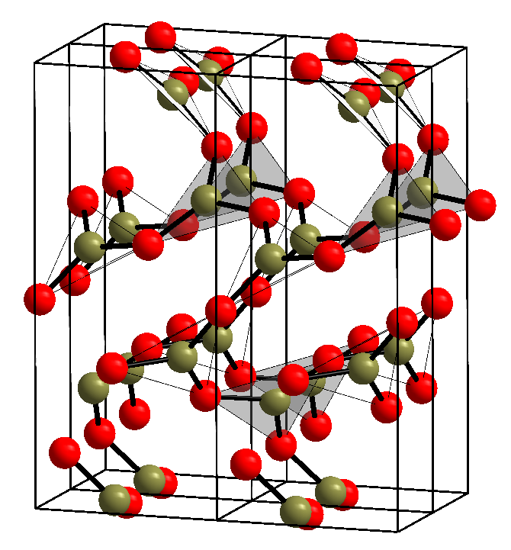
Borate glass
B₂O₃: the glass former consisting of corner-sharing BO₃ triangles connected by bridge oxygen
B
O
O
B
B
O
Boroxol rings: basic structural unit in boric oxide glass
B₂O₃ crystal

Slide 12
Borate glass
B₂O₃: the glass former consisting of corner-sharing BO₃ triangles connected by bridge oxygen
Alkali borate glass:
NBO formation
O
O
+
→
B
O
1/2 Na₂O
B
O⁻ Na⁺
O
O
O
O
O
+
→
B
O
1/2 Na₂O
B⁻
Na⁺
O
O
O
B₃ → B₄ conversion

Slide 13
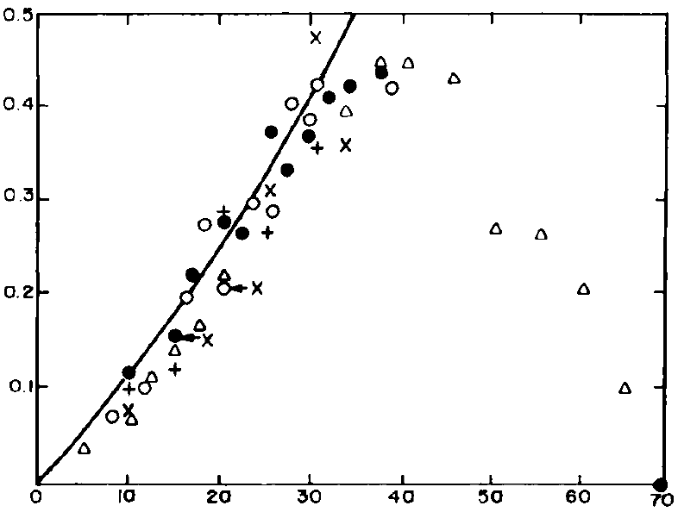
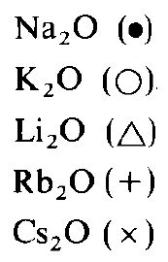
The Boron anomaly
Fraction of 4-fold coordinated boron
Initial addition of alkali ions increases network connectivity, reduces CTE and enhances thermal & chemical resistance
B₃ → B₄ conversion
NBO formation
Molar fraction of alkali (%)

Slide 14
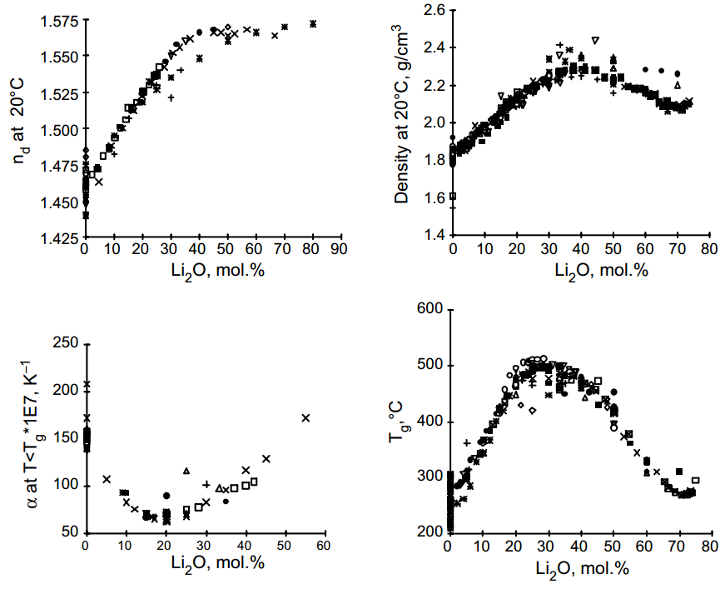
Various properties of lithium borate glass
More than two structural transformations contribute to the boron anomaly
Further reading:
Shelby Ch. 5
J. Non-Cryst. Sol. 351, 1103-1112 (2005)

Slide 15
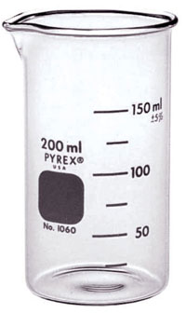
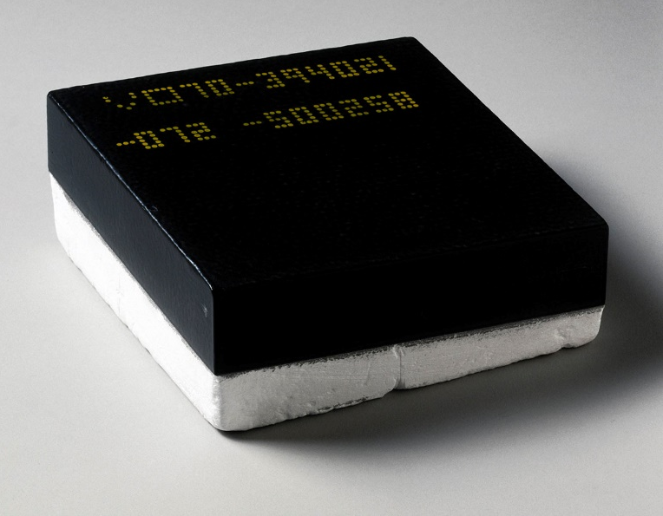
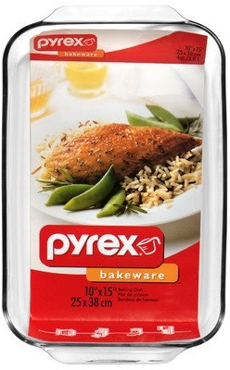
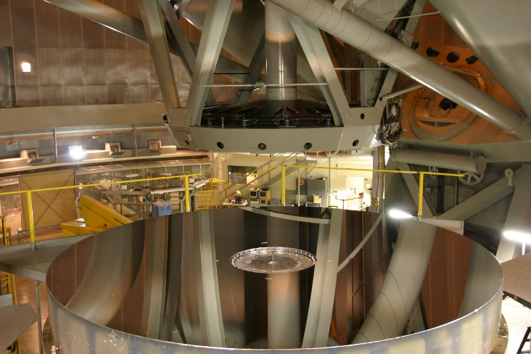
(Alkali) borosilicate glass
Borosilicate glass: x M₂O · y B₂O₃ · (1 - x - y) SiO₂
SiO₂ and B₂O₃ : glass formers
Alkali ions (M⁺) converts B₃ to B₄ states (when x / y < 0.5)
Each additional alkali ion creates one NBO (when x / y > 0.5)
The original Pyrex™ recipe: 4Na₂O·13B₂O₃·2Al₂O₃·81SiO₂
Space shuttle tile coating
200-inch Hale telescope mirror
Notes:
The borosilicate glass coating for space shuttle tile contains carbon and that is why it appears black. See for example patent US 4093771.
Search “Pyrex explosion” on Youtube

Slide 16
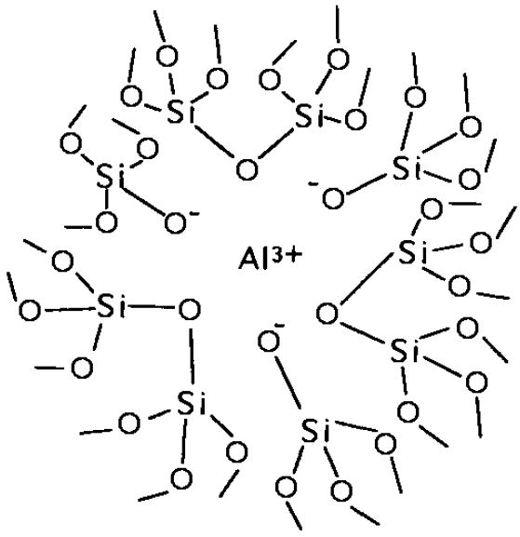
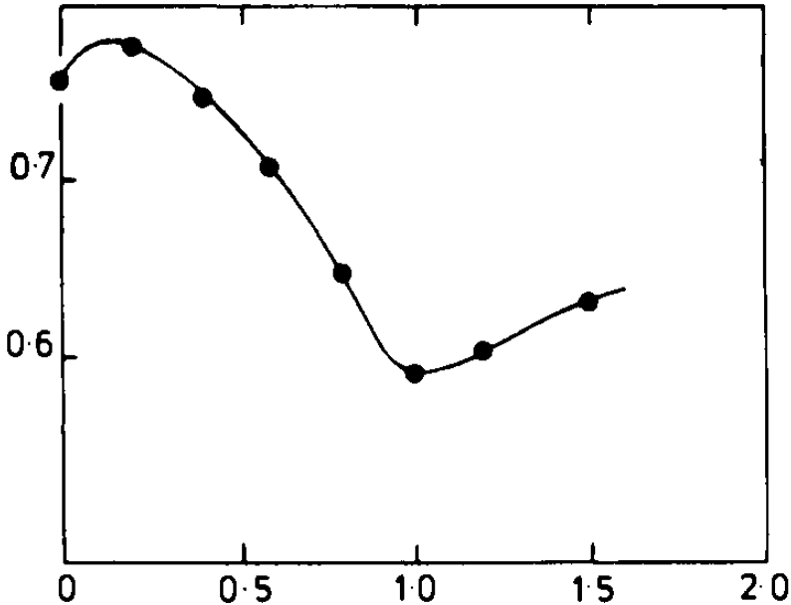
(Alkali) aluminosilicate glass
Aluminosilicate glass: x M₂O · y Al₂O₃ · (1 - x - y) SiO₂
SiO₂ : glass former
Al functions as a glass former in the form of AlO₄ groups (when x > y)
Each excess Al atom creates three NBOs (when x < y)
y = x
Activation energy for DC conductivity
y / x
Al³⁺ in an oxygen octahedron
Notes:
The increase in the activation energy at initial additions of alumina is attributed to the tightening of the structure due to the gradual disappearance of NBO. With further additions of alumina, the activation energy starts decreasing because of the looseness of bonding between the alkali ion and the [AlO4] group. When [Al2O3/M2O] > 1, the activation energy starts increasing again because of the blocking effect of the octahedrally coordinated Al+ ion in the interstices.

Slide 17
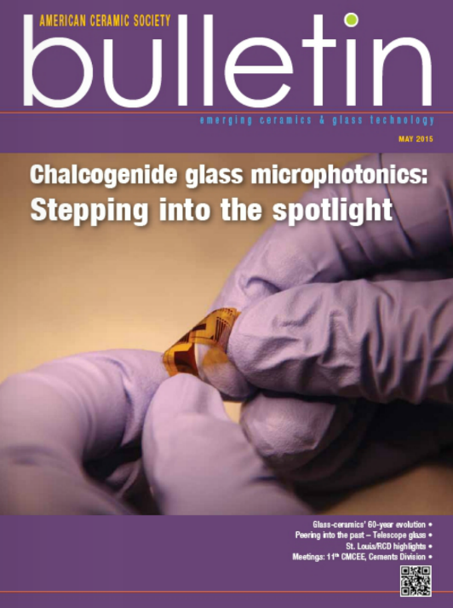
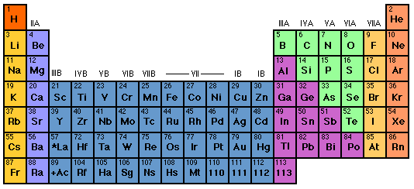
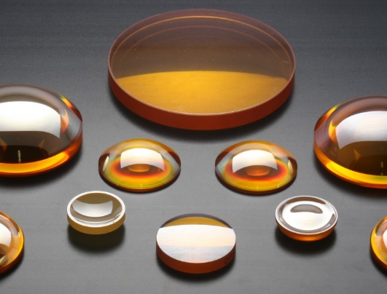
Chalcogenide glass (ChG)
ACerS Bull. 94, 24-29 (2015)
Reduced mechanical strength
Low softening temperature
Low phonon energy (infrared transparency)
Enhanced optical (Kerr) nonlinearity

Slide 18
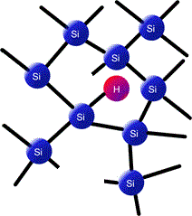
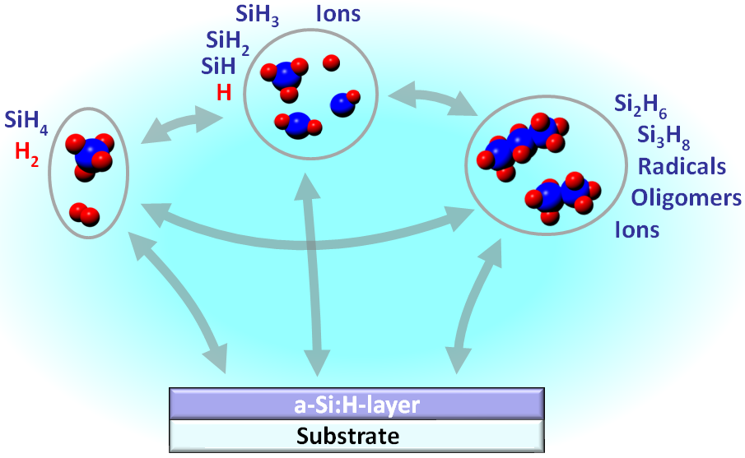
Amorphous semiconductors
Tetrahedral “glasses”
a-Si, a-Ge, a-Si:H (hydrogenated amorphous silicon)
Vapor deposition: plasma enhanced chemical vapor deposition (PECVD), sputtering, electron beam evaporation
Dangling bonds

Slide 19
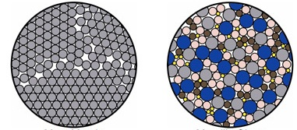
Metallic glass (amorphous metal, glassy metal)
Polycrystalline metal
Amorphous metal
Grain boundaries
Inoue’s empirical rules for bulk metallic glass (BMG) formation
Multicomponent systems consisting of three or more elements
Significant difference in atomic size ratios (frustration)
Negative enthalpy of mixing

Slide 20
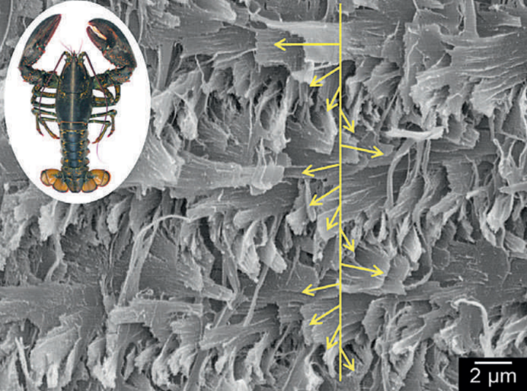
Other glass groups and glass formers
Phosphate glass: P₂O₅
Heavy metal oxide (HMO) and transition metal oxide glass
TeO₂, PbO, Bi₂O₃, V₂O₅, TiO₂, etc.
Halide glass and alloys
e.g. ZBLAN: ZrF₄-BaF₂-LaF₃-AlF₃-NaF
Chalcohalide, oxyhalide, etc.
Amorphous minerals
Opal, biominerals
and many others…
Amorphous calcium carbonate in lobster carapace
“The Formula for Lobster Shell,” Max Planck Research

Slide 21
Representation of glass composition
In oxide glasses, the convention is to list the glass network modifiers in increasing valence order ending with glass network formers
Example: K₂O·CaO·5SiO₂
In mole fraction: 14.3K₂O·14.3CaO·71.5SiO₂
By weight: 20.9K₂O·12.4CaO·66.7SiO₂ (wt%)
In metallic glasses, the listing is usually done in decreasing order of content
Example: Zr_{41.2}Be_{22.5}Ti_{13.8}Cu_{12.5}Ni_{10.0} (Vitreloy-1)
Notes:
There are always exceptions to the conventions

Slide 22
Summary
Glass formers, network modifiers, and intermediates
Silicate glass chemistry
Corner-sharing tetrahedra
Bridging and non-bridging oxygens
Different modifiers: alkali, alkali earth
Borates and boron anomaly
Impact of network connectivity on glass properties
Other glass/amorphous systems
Chalcogenides: weak bonds
Group IV amorphous semiconductors: passivation of dangling bonds
Amorphous metals: w/o grain boundaries

Slide 23
Summary of oxide glass chemistry
 | SiO₂ (silicate) | B₂O₃ (borate)
No modifier | Structural unit: SiO₄ No NBOs, low or negative CTE, high softening point, low diffusivity | Structural unit: BO₃ No NBOs, corrugated layered structure
Alkali oxide | Each ion creates 1 NBO; large CTE, low softening point, poor chemical durability, ionic conductivity | Each ion creates 1 B₄ group or 1 NBO; extremum in glass properties (boron anomaly)
Alkaline earth oxide | Each ion creates 2 NBOs; similar effects as alkali ions although some network connectivity is preserved | Each ion creates 2 B₄ groups or 2 NBOs; extremum in glass properties (boron anomaly)
Alumina (Al₂O₃) | Each ion creates 3 NBOs; in the presence of alkali ions Al₃ → Al₄ conversion occurs | B₂O₃ and Al₂O₃ both serve as glass formers; glass is stable only with high B₂O₃ content

