Slide 1
MIT 3.156/3.46
Photonic Materials and Devices
2: Electromagnetic Wave Theory
Juejun (JJ) Hu
hujuejun@mit.edu

Slide 2
References
Fundamentals of Photonics, Ch. 2 and 5
Photonics: Optical Electronics in Modern Communications, Ch. 1
Principles of Nano-optics, Ch. 2

Slide 3
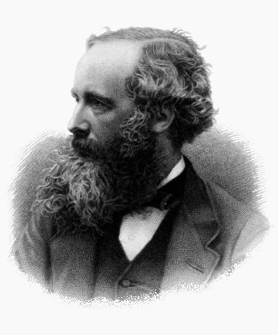
Maxwell Equations (‘macroscopic’ differential form)
Gauss’s Law:
Gauss’s Law for magnetism:
Faraday’s Law:
Ampere’s Law:
James C. Maxwell (1831-1879)
H | Magnetic field | B | Magnetic induction
E | Electric field | D | Electric displacement
J_{f} | Free current density | ρ_{f} | Free charge density

Slide 4
Charge conservation
Ampere’s Law:
Gauss’s Law:
Vector identity:
Charge conservation:
Free electric current flowing through any enclosed surface S is equal to the change rate of free charge within the surface

Slide 5
Constitutive relations
General form for non-bianisotropic media:
Linear (low light intensity), isotropic media
  Non-ferroelectric & non-ferromagnetic crystals with a cubic lattice (rock salt, silicon, gold, etc.)
  Amorphous glasses and polymers
  E and D (or B and H) always align in the same direction
  In most non-magnetic materials, μ_{r} is very close to 1 (μ = μ₀)
Non-magnetic media
Notes:
See J. A. Kong’s book for a complete discussion about bianisotropic media

Slide 6
Constitutive relations (cont’d)
Linear, electrically or magnetically anisotropic media:
  Non-cubic crystals
  Poled glasses and polymers
Principal system
P | Polarization | M | Magnetization
ε₀ | Vacuum permittivity = 8.85 × 10⁻¹² F/m | μ₀ | Vacuum permeability = 1.26 × 10⁻⁶ N/A²
ε | Permittivity | μ | Permeability
χ | Electric susceptibility | χ_{m} | Magnetic susceptibility
Notes:
See J. A. Kong’s book for a complete discussion about bianisotropic media

Slide 7
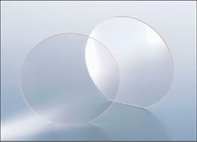

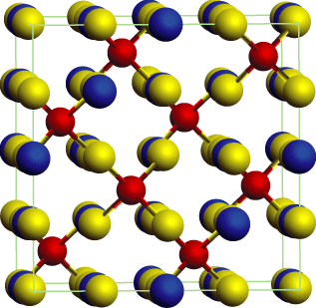
Transparent polycrystalline ceramics
Typical opacity of polycrystalline materials: scattering
Sources of scattering
  Grains with different orientations
  Inter-grain secondary phases
Solution:
  Cubic lattice material (isotropic)
  Processing optimization to eliminate secondary phases
LumiceraTM, Murata Inc.
Advantages
  Superior mechanical strength
  High refractive index and damage threshold
Spinel structure (cubic)

Slide 8
Wave equation in source-free, isotropic media
Source-free, isotropic media:
Vector identity
Wave equation (vectorial equation: 6 equations total)
Non-magnetic media

Slide 9
Helmholtz equation for monochromatic waves
Wave equation:
Monochromatic wave: single angular frequency ω
Helmholtz equation:
Complex amplitude
Define
wave velocity
wave number (a scalar)

Slide 10
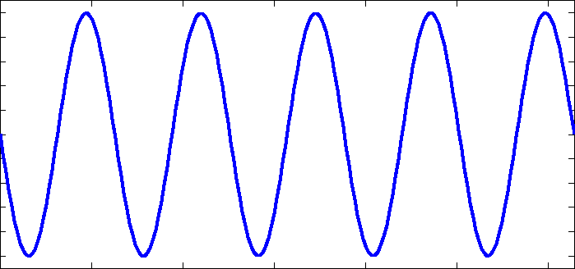
Monochromatic plane wave solution
Plane wave solution:
Amplitude (real):
Phase:
Wave vector :
  A measure of spatial period
0
2A
λ
where

Slide 11
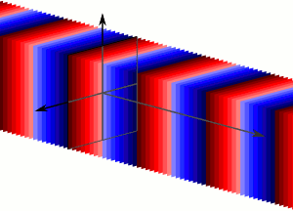
Monochromatic plane wave solution (cont’d)
z
Phase:
0
2A
y
λ
The surfaces of constant phase (wave front) are parallel planes perpendicular to the wave propagation direction
x
Example:
Wave front:
A set of parallel planes moving along the x-axis at the velocity of c

Slide 12
Monochromatic plane wave solution (cont’d)
Plane wave solution in vacuum:
Plane wave in an isotropic, linear medium
n : refractive index
Non-magnetic media

Slide 13
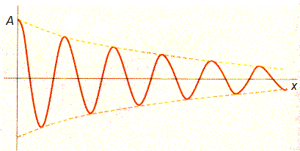
Complex refractive indices
Complete description of material optical properties
  n_{r} : polarizability
  K : loss (dimensionless)
Absorption coefficient in cm⁻¹
Attenuation

Slide 14
Kramers-Kronig (K-K) relation
n_{r} (refractive index) and K (absorption) are interdependent
Allows us to relate the real and imaginary parts of the susceptibility function:
  Formally symmetric with respect to real and imaginary parts
In non-magnetic media:
(dilute gas)

Slide 15
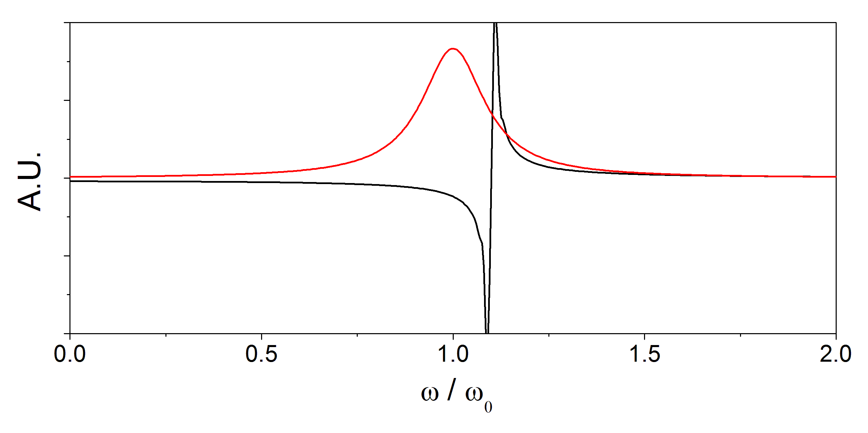
Kramers-Kronig (K-K) relation (cont’d)
ω₀
α(ω)
1/(ω² - ω₀²)
Positive contribution
Negative contribution
Normalized angular frequency
K-K relation:

Slide 16
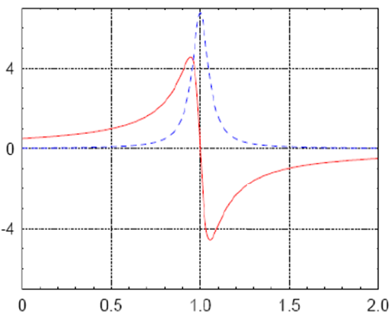
Kramers-Kronig (K-K) relation (cont’d)
α (ω)
n_{r} (ω) -1
Refractive index data:
http://www.ioffe.ru/SVA/NSM/nk/index.html
http://www.luxpop.com/
ω / ω₀

Slide 17
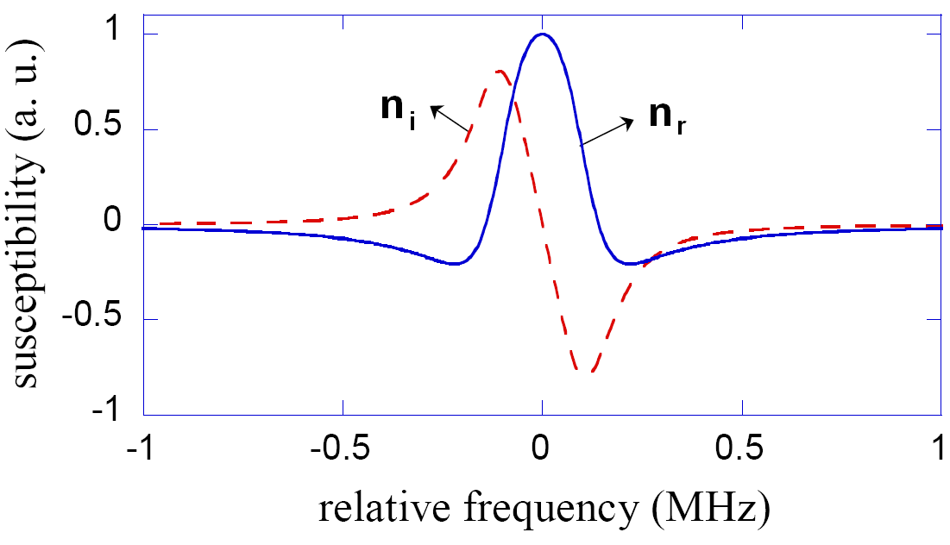
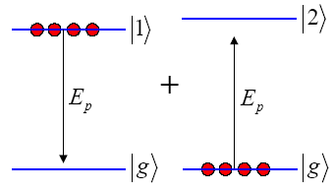
Increasing n_{r} via quantum coherence
High refractive index material is attractive for a number of applications, e.g. high NA immersion photolithography
Is refractive index enhancement always accompanied by absorption increase?
(K)
(n)
Theoretical proposal: M. Scully, “Enhancement of index of refraction via quantum coherence,” Phys. Rev. Lett. 67, 1855 (1991).
Experimental realization: N. Proite et al., “Refractive Index Enhancement with Vanishing Absorption in an Atomic Vapor” Phys. Rev. Lett. 101, 147401 (2008).

Slide 18
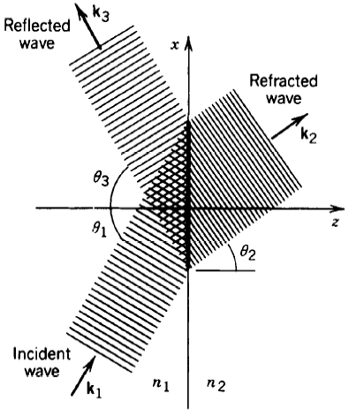
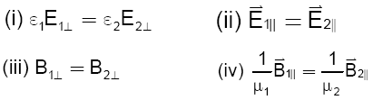
Transmission through dielectric interfaces
Boundary conditions of fields
  The conditions have to be satisfied everywhere and at all times on the boundary
Derivation of Snell’s law
  Phase matching: continuity of
  E-field across the boundaries
Snell’s law

Slide 19
Fresnel equation at normal incidence
Continuity of E-field parallel to interface
E _{i} + E _{r} = E _{t}
Boundary condition of B-field parallel to interface
Field induction
Fresnel equation: reflection coefficients
Half wave loss: n₁ < n₂
  π phase shift between incident
  and reflected wave
n₁ = n₂ : index matching, R = 0
E_{i}
B_{i}
B_{r}
E_{r}
n₁
n₂
B_{t}
E_{t}
Boundary conditions

Slide 20
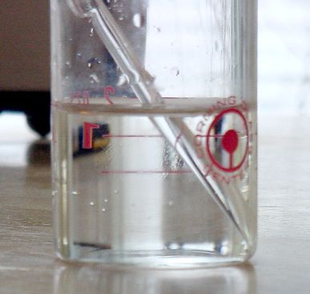
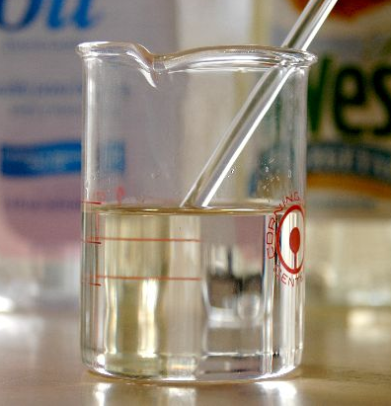
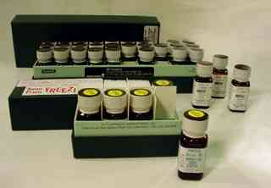
Refractive index matching liquids
Quoted from “How to make glass disappear in a liquid”
A Pyrex rod in water
In index matching oil
Applications:
Reduce Fresnel losses in fiber optics
Refractometry: calibrate instruments
Strain analysis of transparent materials

Slide 21
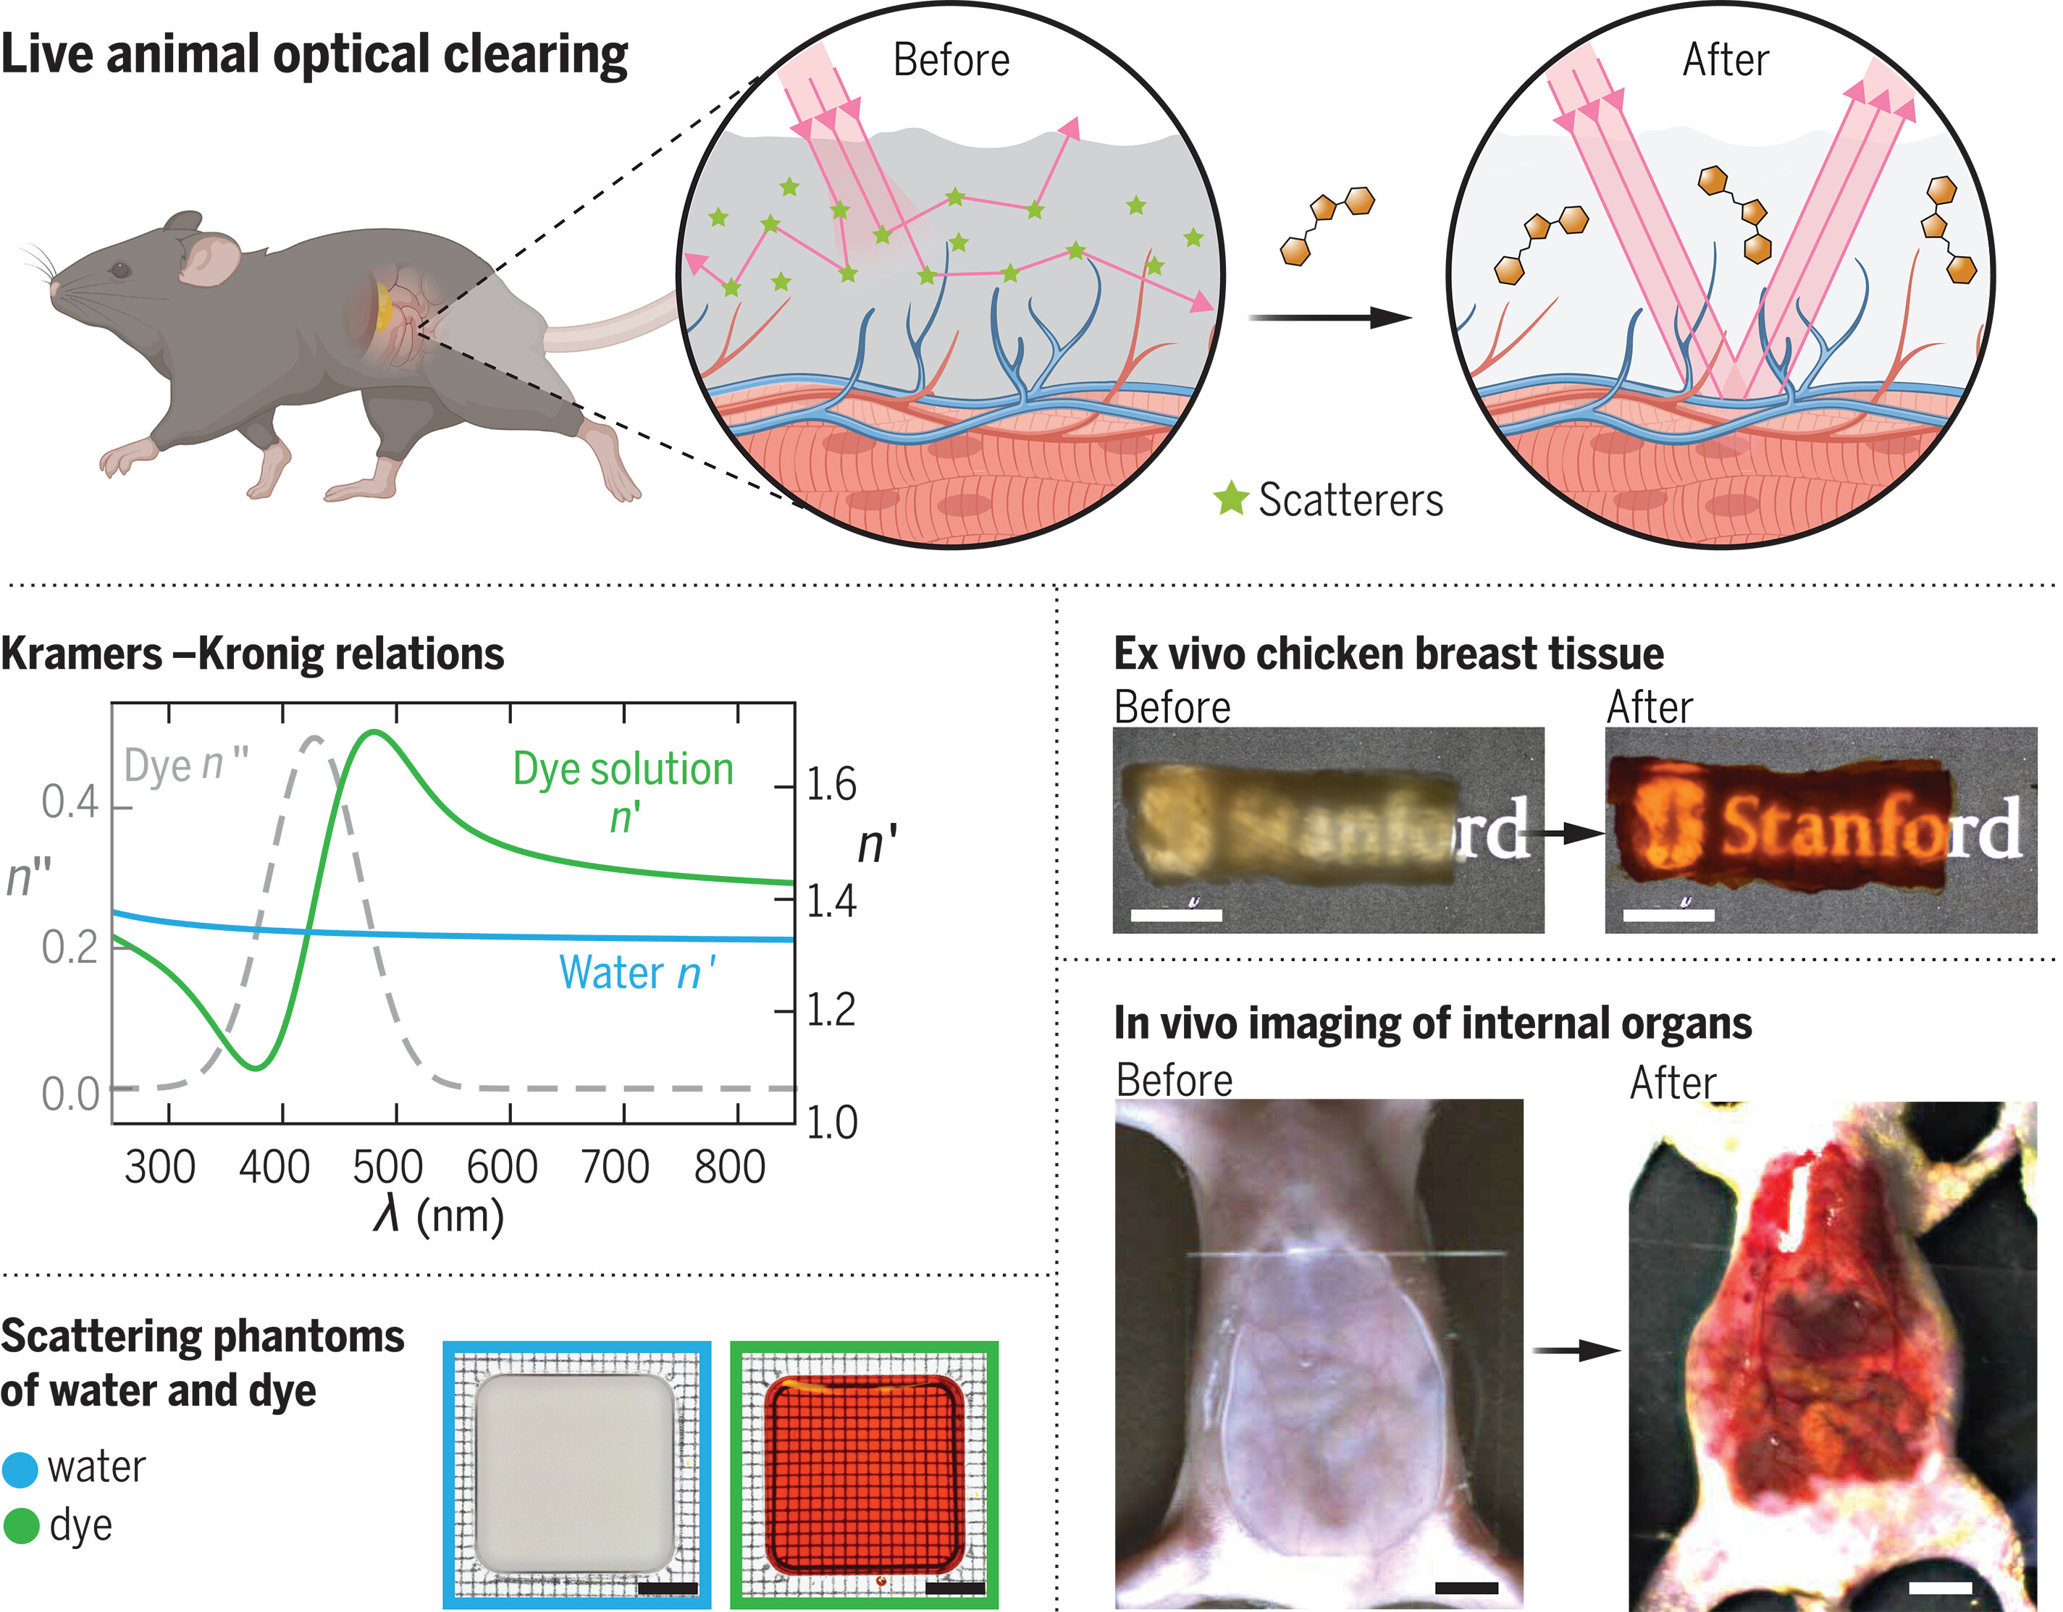
Index matching solution for live tissue imaging
Water solution index matched to live tissues reduces optical scattering
Enhancing solution index by adding dyes with absorption peaks in the UV
Science 385, 1061 (2024)

Slide 22
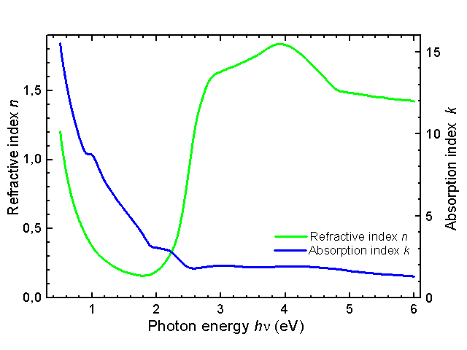

Refractive index of gold
n ~ 0.37 @ 1 eV
Experimental value: R > 90%
Why is that ???
Imaginary part of index n (extinction coefficient) contributes to reflection as well!

Slide 23
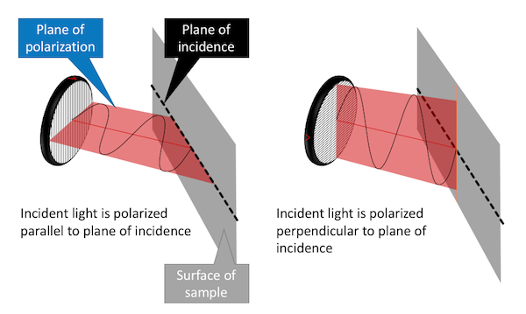
Linearly polarized wave optical reflection
TE (transverse electric, s-polarized) polarization
  Electric field parallel to substrate surface
TM (transverse magnetic, p-polarized) polarization
  Magnetic field parallel to substrate surface
Electric field
TM or p-polarized
TE or s-polarized
Electric field

Slide 24
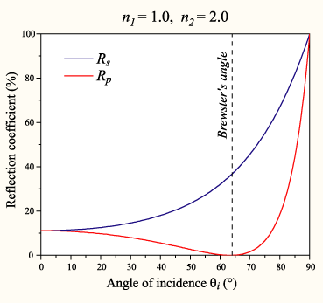
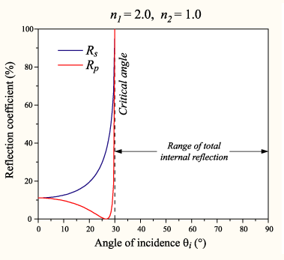
Linearly polarized wave optical reflection
TE (transverse electric, s-polarized) polarization
  Electric field parallel to substrate surface
TM (transverse magnetic, p-polarized) polarization
  Magnetic field parallel to substrate surface
low index
high index
high index
low index
TE
TM
TE
TM

Slide 25
Transfer matrix method (TMM)
?
?
Reflected light
n₁
n₂
n₃
n_{i-1}
n_{i}
Refracted light
…
d₁
d₂
d₃
d_{i-1}
d_{i}
Incident light
Interface
TE polarization:
2
B₂
3
E₃
E₂
B₃
E₁
B₄
E₄
Boundary conditions
1
B₁
4
(i)
(t)

Slide 26
Transfer matrix method (TMM)
?
?
Reflected light
n₁
n₂
n₃
n_{i-1}
n_{i}
Refracted light
…
d₁
d₂
d₃
d_{i-1}
d_{i}
Incident light
Interface matrix (TE):
Interface matrix (TM):

Slide 27
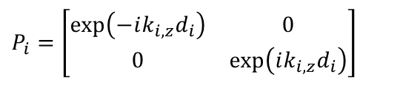
Transfer matrix method (TMM)
?
?
Reflected light
n₁
n₂
n₃
n_{i-1}
n_{i}
Refracted light
…
d₁
d₂
d₃
d_{i-1}
d_{i}
Incident light
Layer
Propagation matrix
2
4
$$P_{i}=\left[\begin{matrix}\exp\left(−ik_{i,z}d_{i}\right) & 0 \\ 0 & \exp\left(ik_{i,z}d_{i}\right)\end{matrix}\right]$$
1
3
Phase delay
(i)

Slide 28
Transfer matrix method (TMM)
?
?
Reflected light
n₁
n₂
n₃
n_{i-1}
n_{i}
Refracted light
…
d₁
d₂
d₃
d_{i-1}
d_{i}
Incident light
Transfer matrix
Transmittance:
Reflectance:

Slide 29
Practical considerations in TMM applications
Anisotropic and magneto-optical media
  S. Teitler and B. Henvis, "Refraction in Stratified, Anisotropic Media," J. Opt. Soc. Am. 60, 830-834 (1970).
  H. Kato, T. Matsushita, A. Takayama, M. Egawa, K. Nishimura, and M. Inoue, "Theoretical analysis of optical and magneto-optical properties of one-dimensional magnetophotonic crystals," J. Appl. Phys. 93, 3906-3911 (2003).
Thick samples (compared to coherent length of light)
  C. Katsidis and D. Siapkas, "General Transfer-Matrix Method for Optical Multilayer Systems with Coherent, Partially Coherent, and Incoherent Interference," Appl. Opt. 41, 3978-3987 (2002).

Slide 30
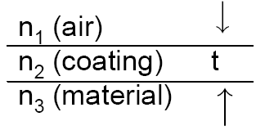
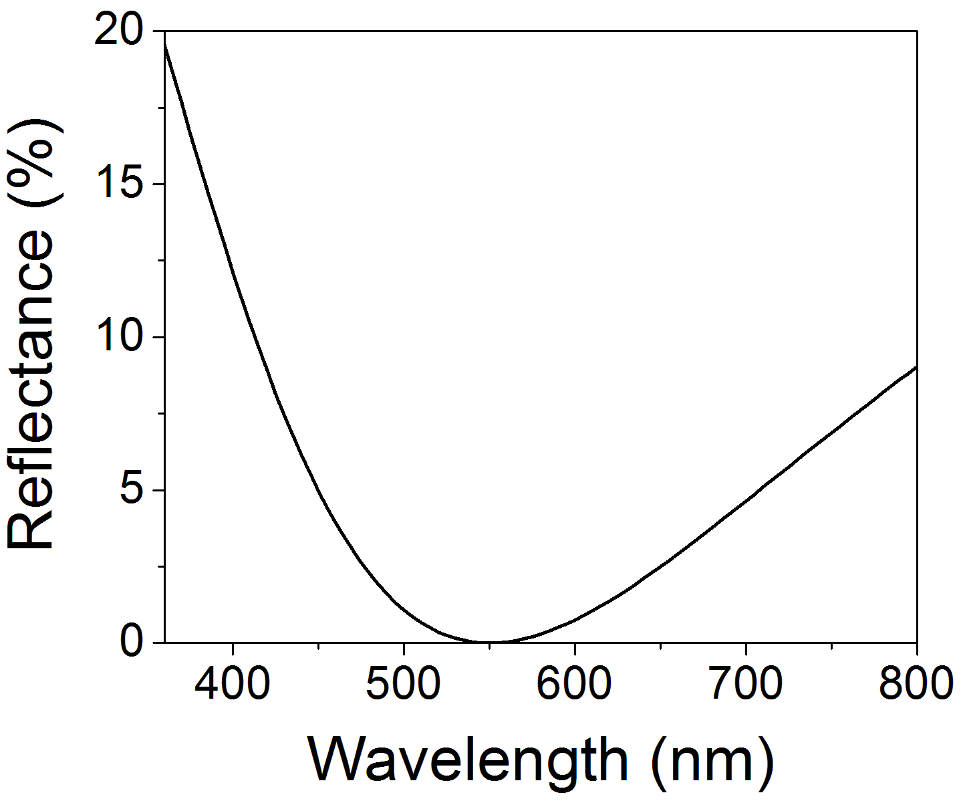
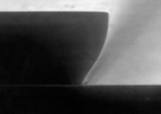
Anti-reflection coatings (ARCs)
Minimize reflection on surfaces
  Solar cells, detectors, lithography
when
Resist pattern w/o AR coating
Wavy patterns on pattern edge due to reflection/interference
Single ARC layer on Si designed for λ = 550 nm
Quarter-wavelength layer
Smooth pattern edge

Slide 31
Distributed Bragg Reflectors (DBRs)
Quarter-wavelength stack (1-D photonic crystal)
  Index sequence: H – L – H – L …
  High index contrast leads to large stop band (high reflectance band) bandwidth and increased reflectance
Air
H
n_{H} = 3.46
n_{L} = 1.33
L
H
L
n_{H} = 2.00
n_{L} = 1.33
H
L
High-index substrate

Slide 32
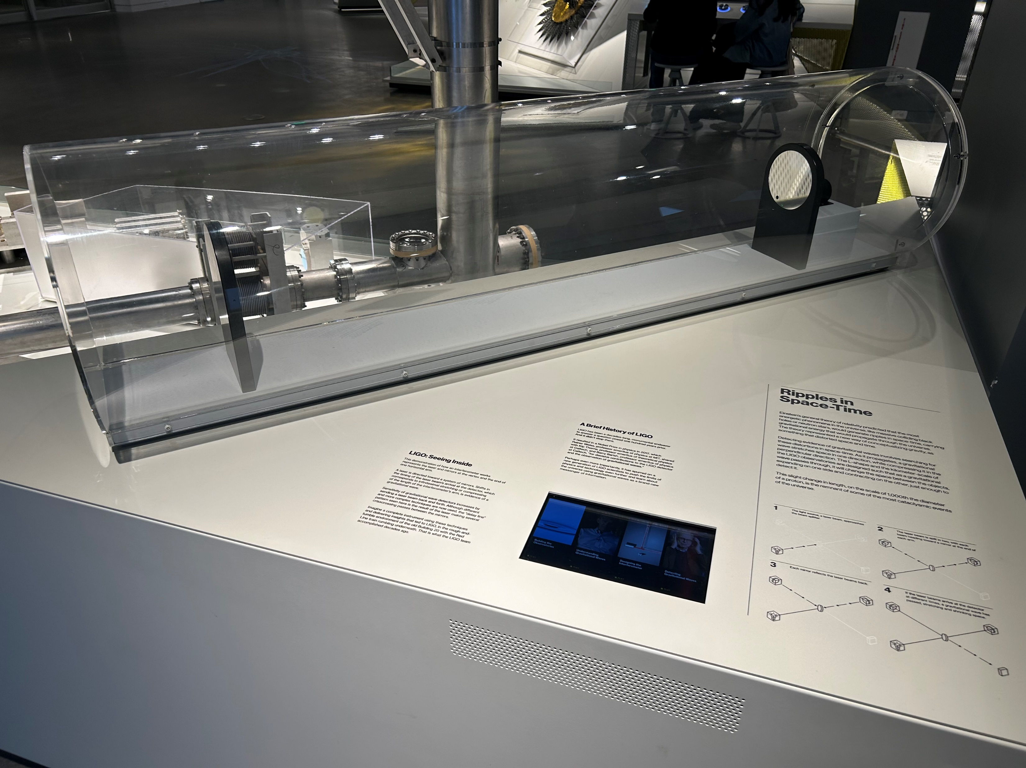
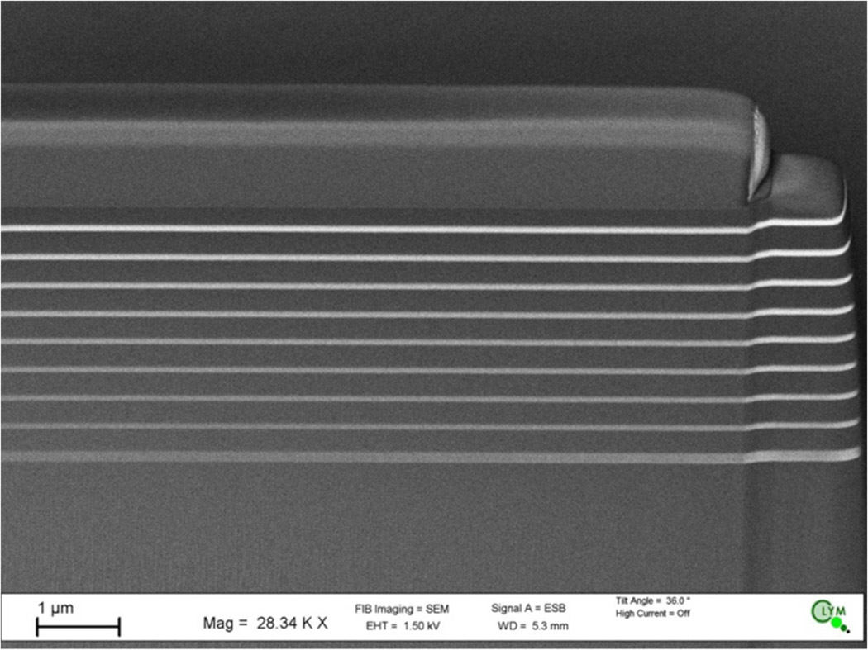
DBRs for gravitational wave detection
Advanced optical coatings for the discovery of gravitational waves
LIGO @ MIT Museum

Slide 33
Distributed Bragg Reflectors (DBRs)
In the frequency domain, the stop bands periodically appear at odd integral multiples of the 1st stop band center frequency
Why the stop band does not appear at even multiples?
First stop band center frequency: 1000 cm⁻¹

Slide 34
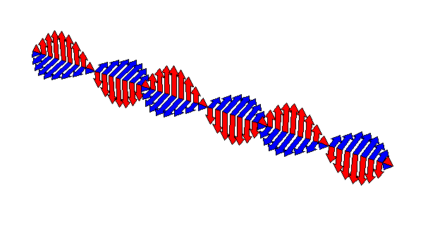
Poynting vector and energy flux
Energy flux of electromagnetic waves:
Time-averaged energy flux:
E
S, k
H

Slide 35
List of symbols
D – electric displacement
ρ_{f} – free charge density
B – magnetic induction
E – electric field
H – magnetic field
J_{f} – free current density
t – time
Q_{f} – amount of free charge within an enclosed surface S
ω – angular frequency
λ – wavelength of light

Slide 36
List of symbols
P – electric polarization (density)
M – magnetization or magnetic polarization (the same letter is also used to denote transfer matrix)
ε₀ – vacuum permittivity, 8.854 × 10⁻¹² C/Vm
μ₀ – vacuum permeability, 1.26 × 10⁻⁶ H/m
ε – (absolute) permittivity
μ – permeability
χ – electric susceptibility
χ_{m} – magnetic susceptibility
A – (real) wave amplitude

Slide 37
List of symbols
c – wave velocity
k – wave number
– wave vector
– position vector
k₀ – wave number in free space
c₀ – speed of light in vacuum, 2.99792458 × 10⁸ m/s
ε_{r} – relative permittivity or dielectric constant
μ_{r} – relative permeability, ~ 1 for non-magnetic media
n – refractive index
n_{r} – real part of refractive index

Slide 38
List of symbols
K – imaginary part of refractive index or extinction coefficient
α – absorption coefficient
E┴ / B┴ – electric / magnetic field component perpendicular to an interface
E// / B// – electric / magnetic field component parallel to an interface
θ – angle of incidence, reflection or refraction
k_{x} / k_{y} / k_{z} – wave vector component along x / y / z axis
E_{i} / E_{r} / E_{t} – electric field of incident / reflected / transmitted wave

Slide 39
List of symbols
B_{i} / B_{r} / B_{t} – magnetic field of incident / reflected / transmitted wave
R – reflectance or intensity reflection coefficient
– Poynting vector

