Slide 1
MIT 3.156/3.46
Photonic Materials and Devices
5: Optical Resonant Cavities
Juejun (JJ) Hu
hujuejun@mit.edu

Slide 2
Optical resonance and resonant cavities
Optical resonant mode
  A time-invariant, stable electromagnetic field pattern (complex amplitude): an eigen-solution to the Maxwell equations
  Discretized resonant frequencies (eigen-values), i.e. these modes appear only at particular frequencies/wavelengths
  The modal fields are usually spatially confined in a finite domain
Optical resonant cavities (resonators)
  Devices that support optical resonant modes
Guided mode resonance, surface plasmon (polariton) resonance, and spoof surface plasmon resonance all refer to coupling to propagating modes, even though the same term “resonance” is referenced!

Slide 3
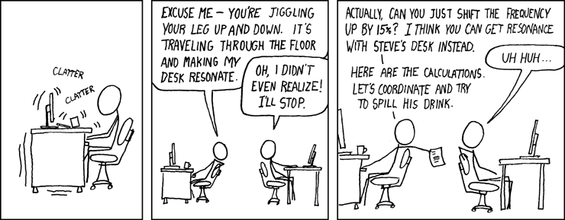
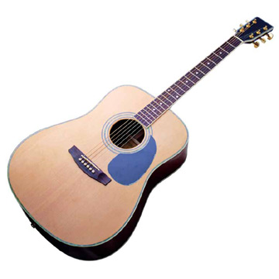
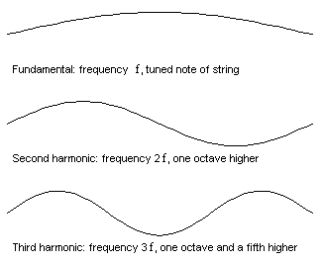
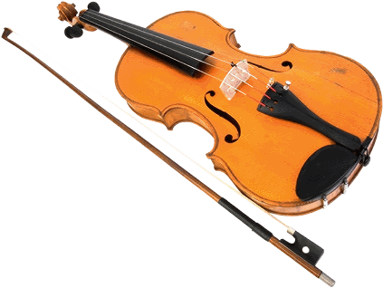
Resonance: a mechanical analog
The resonance frequency of a string determines the pitch of sound it produces

Slide 4
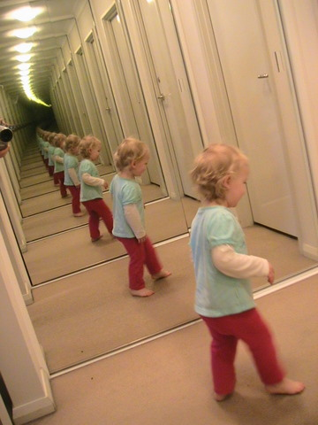


An infinite corridor in two mirrors
Electromagnetic waves between two perfect conductors (perfect mirrors)
Photon
Interference between back-and-forth reflected light
Standing wave formation

Slide 5
A ray tracing model
Field amplitude: 1
t₁, r₁
t₂, r₂
a₁
a₂
…
…
a_{n}
α = 2πK/λ, L
Transmission coefficient
when |r| < 1
Ray tracing: summation of field amplitude, taking into account interference effect (the phase term)

Slide 6
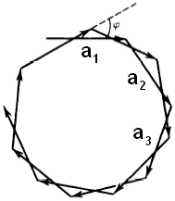

A close inspection of phasor summation
Transmission coefficient
when |r| < 1
Eq. (1)
A vector on the complex plane with a modulus/length ≤1
Phasor
Firstly let’s look at a lossless cavity, i.e. α = 0, r₁ = r₂ = 1, and thus |r| = 1.
When kL ≠ Nπ, the vectors have different directions…
When kL = Nπ, the vectors are aligned (resonant condition).
Transmission spectra
T_{tot}
Free Spectral Range
FSR = πc/L
Finite, non-vanishing transmitted intensity ONLY at resonance
ω
Peak FWHM = 0

Slide 7
A close inspection of phasor summation
Transmission coefficient
when |r| < 1
Eq. (1)
A vector on the complex plane with a modulus/length ≤1
Phasor
When there is loss in the cavity, |r| < 1, and Eq. (1) holds
The transmission spectra have non-vanishing values even when the resonant condition is not met!
Transmission spectra
T_{tot}
Free Spectral Range
Quality factor Q:
Cavity finesse:
FSR = πc/L
ω
FSR: Free Spectral Range, peak separation
ω₀ : resonant (angular) frequency
Δω : peak FWHM (Full Width at Half Maximum)
Peak FWHM ≠ 0!
Extinction ratio: 10·log₁₀(T_{max}/T_{min})

Slide 8
Standing wave modes in F-P cavities
x
t₁, r₁
y
z
t₂, r₂
…
α = 2πK/λ, L
Cavity field:

Slide 9
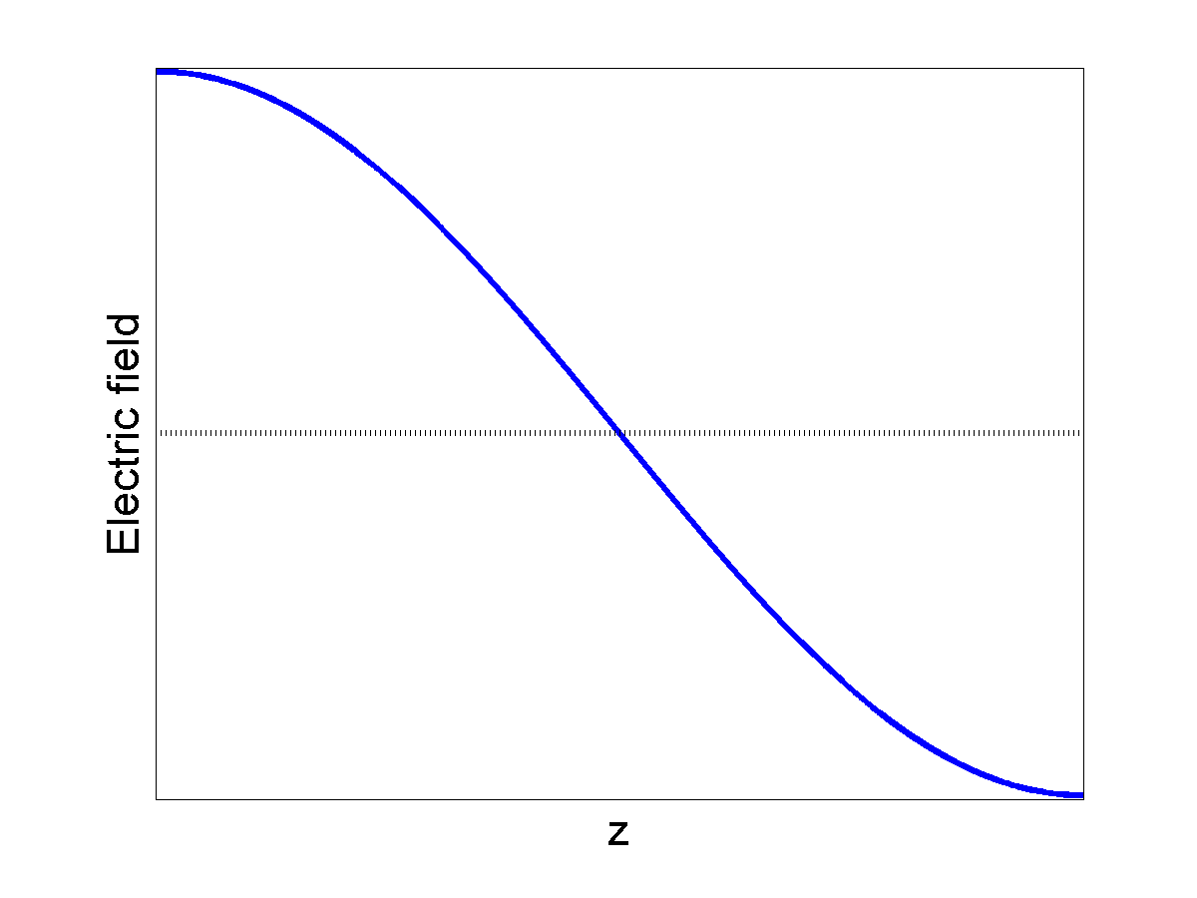
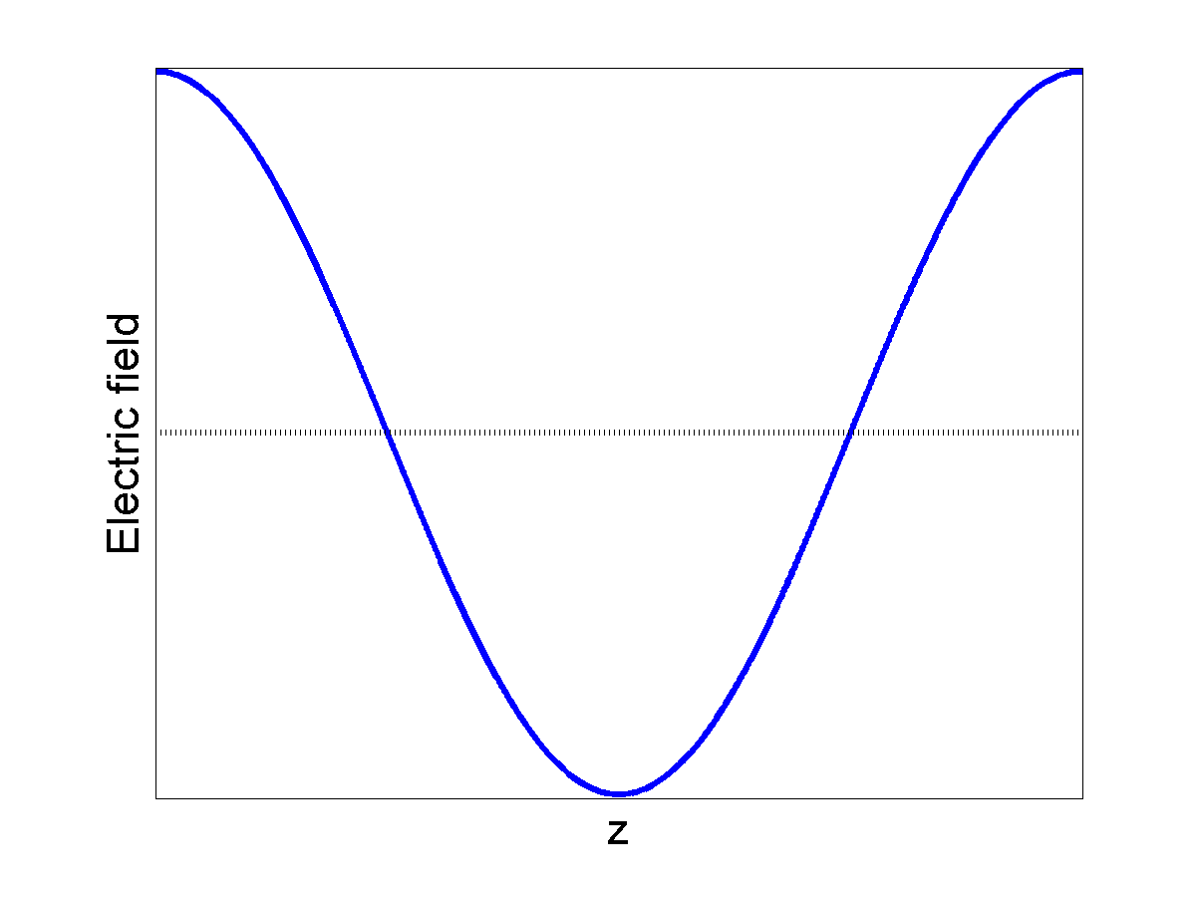
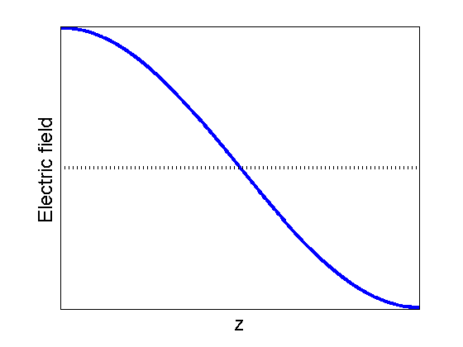
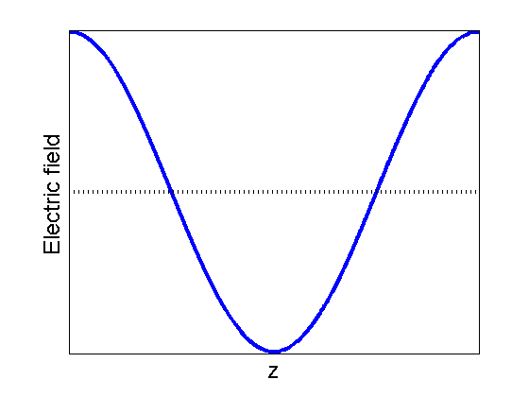
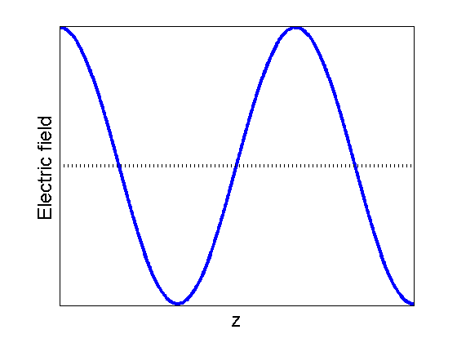
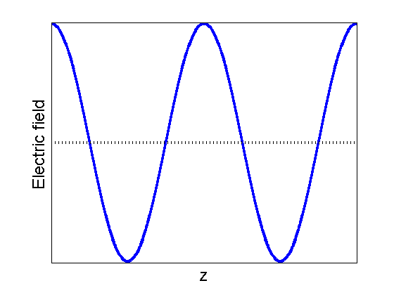
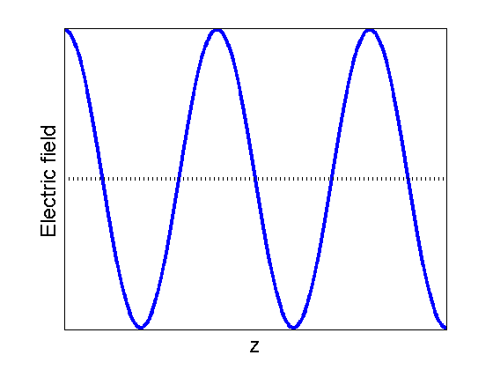
Standing wave modes in F-P cavities (cont’d)
N = 1
N = 2
N = 3
N = 4
N = 5
…

Slide 10
Important concepts
Quality factor (Q-factor)
Finesse
Free spectral range (FSR, frequency domain)
W : Energy stored in the cavity in J
P_{loss} : Power loss in J/s or W
Include the factor 2 for travelling wave cavities
Include the factor 2 for travelling wave cavities

Slide 11
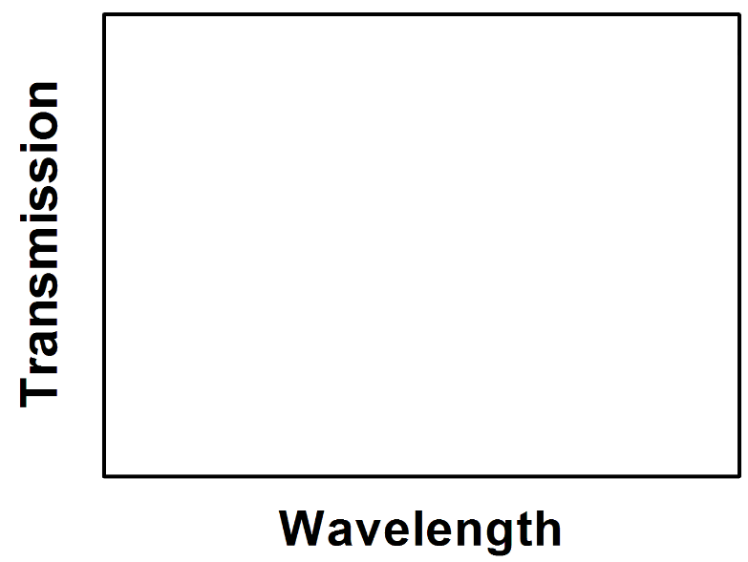
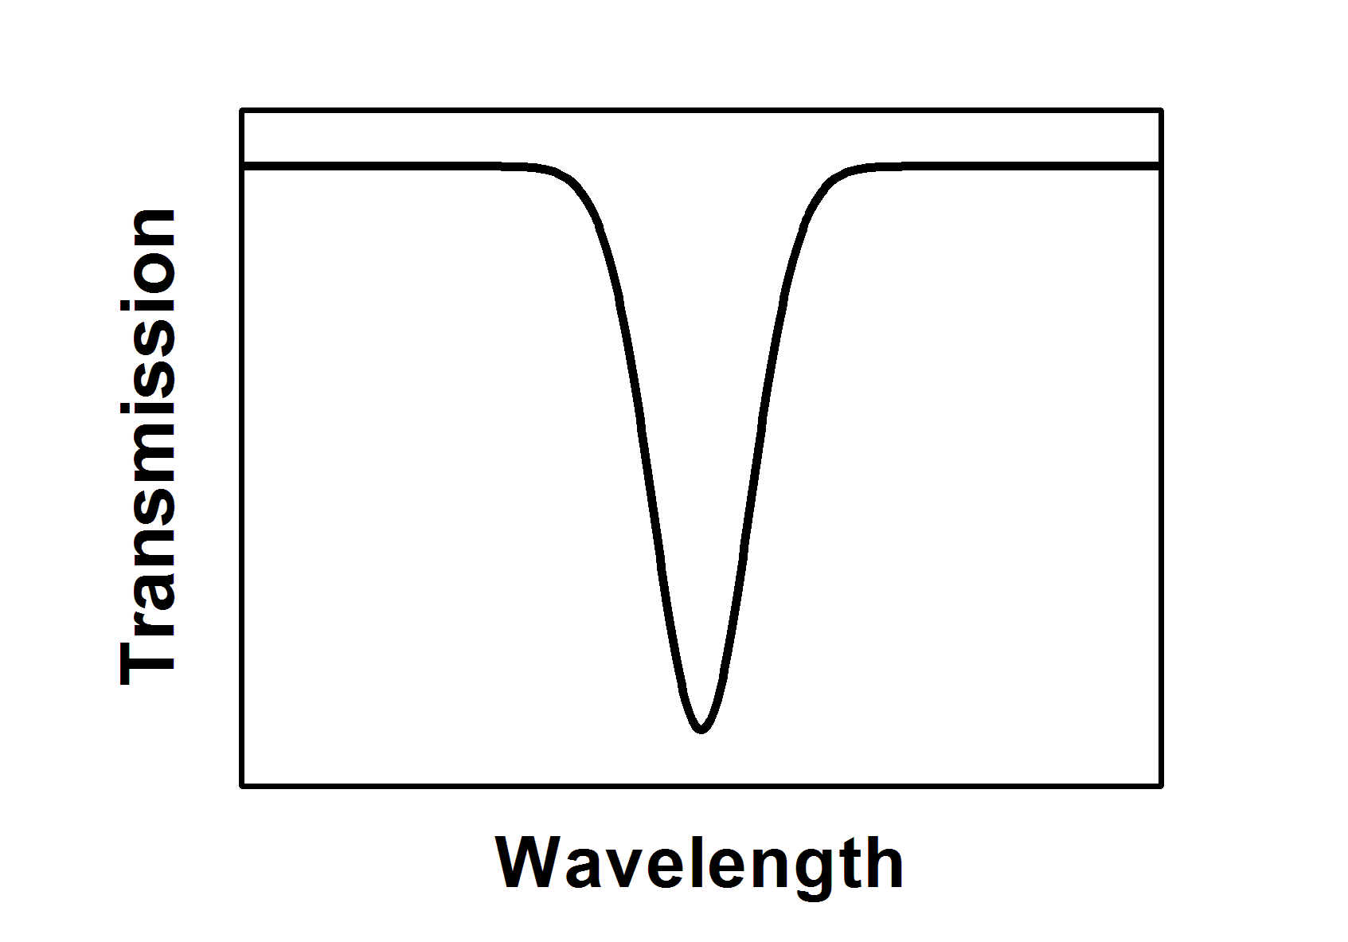
Important concepts
Free spectral range (FSR)
Quality factor (Q-factor)
Finesse
Traveling wave cavity
wavelength domain
FSR
W : Energy stored in the cavity in J
P_{loss} : Power loss in J/s or W
Full width at half maximum (FWHM) Δλ should be calculated in linear scale, not in dB scale!
Reference: Juejun Hu, Ph.D. thesis, Appendix I

Slide 12
Optical loss in cavities
Round trip loss in an F-P cavity
Coupling loss (mirror loss):
  Non-unity mirror reflectance
  Independent of cavity length
Internal loss (distributed loss):
  Absorption/scattering of light in the cavity
  Loss proportional to cavity length L
Both Q and finesse scales inversely with cavity loss
  If distributed loss dominates, Q is independent of cavity length
  If coupling loss dominates, F is independent of cavity length

Slide 13
Cavity perturbation theory
Resonant frequency shift due to perturbation
Material perturbation
Shape perturbation
The frequency shift scales with field intensity
ε
ε + Δε
ε
ε
S. Johnson et al., ”Perturbation theory for Maxwell’s equations with shifting material boundaries,” Phys. Rev. E 65, 066611 (2002).

Slide 14
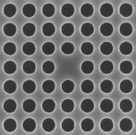
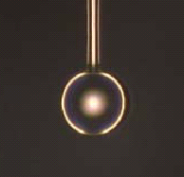
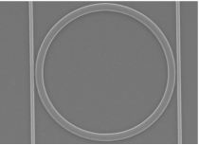
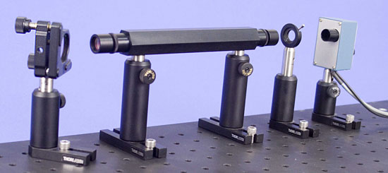
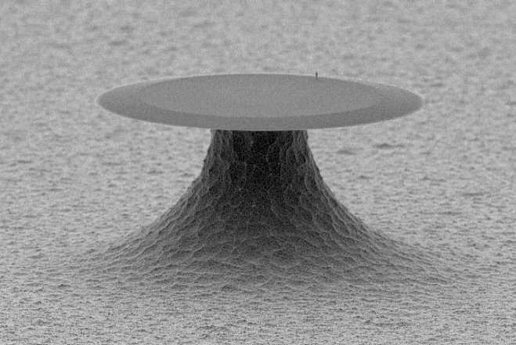
Standing wave vs. travelling wave cavities
Standing wave resonators
Photonic crystal (PhC) cavity / Fabry-Perot (F-P) cavity
Light forms a standing wave inside the cavity
Traveling wave resonators
Micro-ring/disk/racetrack resonators, microspheres
Light circulates inside the resonant cavity
2-d PhC cavity (top-view)
Micro-ring
F-P cavity
Microsphere attached to a fiber end
Micro-disk

Slide 15
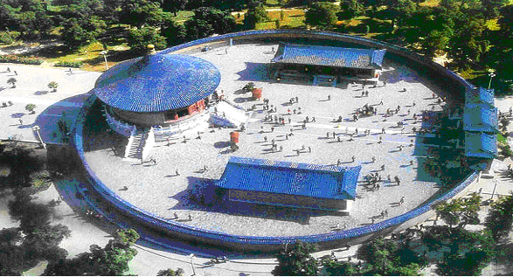

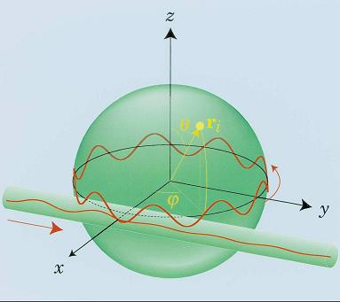
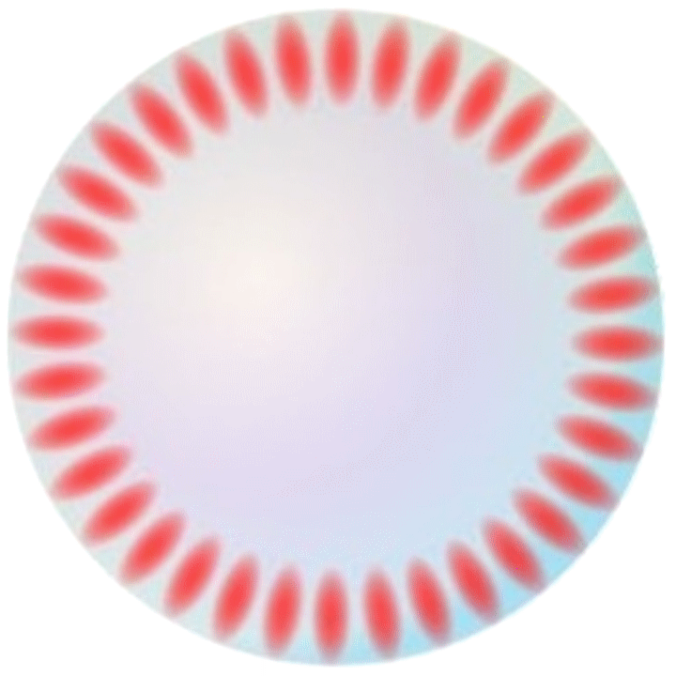
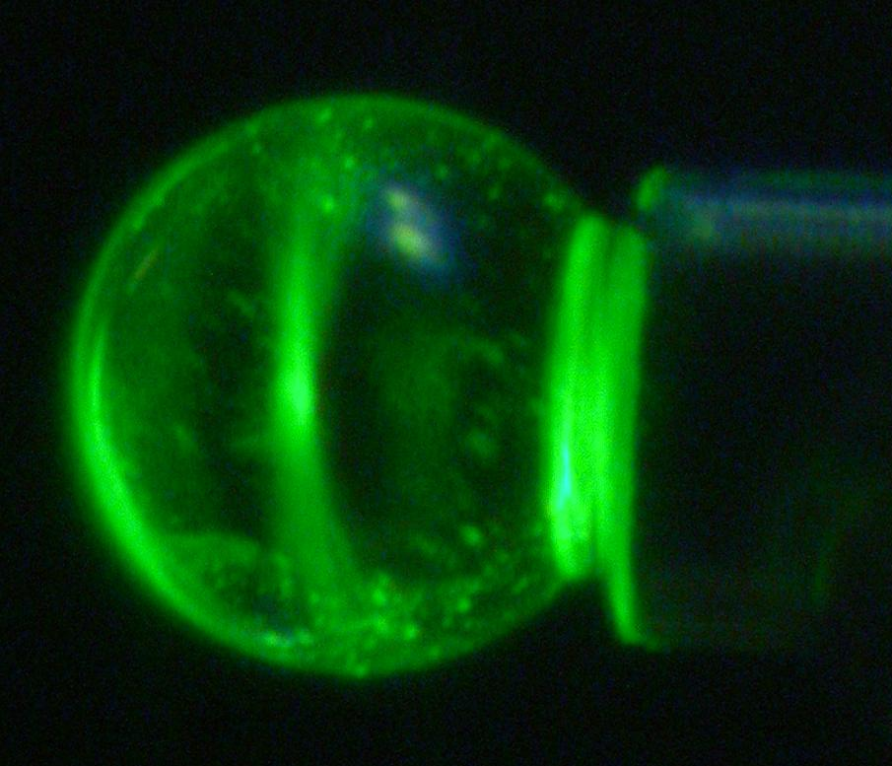
Whispering gallery mode
Acoustics
Sound wave
Optics
CW mode

Slide 16
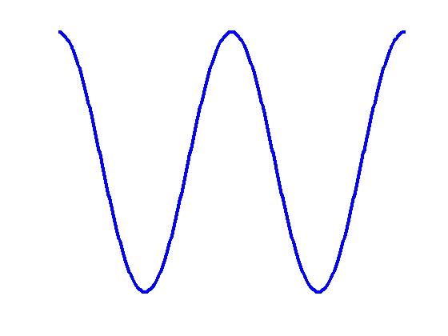
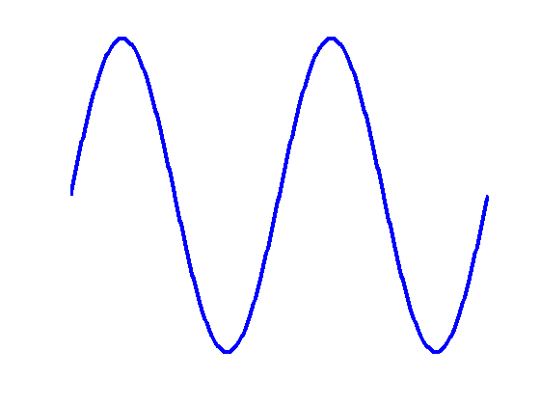
Standing wave vs. travelling wave cavities
Standing wave resonators
Light forms a standing wave inside the cavity
Traveling wave resonators
Light circulates inside the resonant cavity
z
z
z
z
z
+
z
=
z
Azimuthally symmetric travelling wave cavities support CW & CCW travelling wave modes as well as standing wave modes; and they are all degenerate (i.e. same resonant frequency)

Slide 17
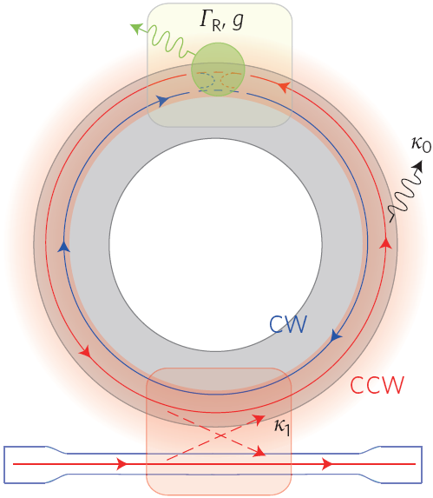
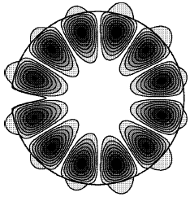
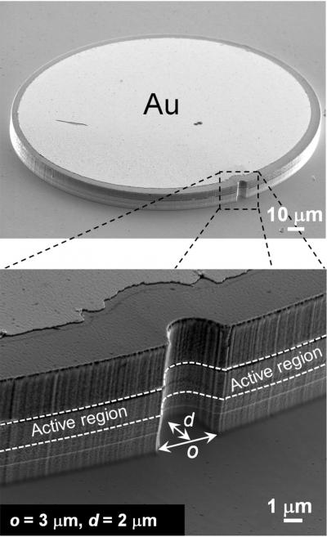
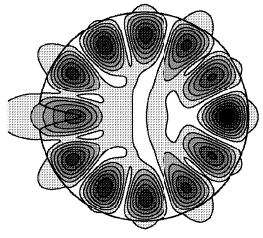
Degeneracy lifting in travelling wave cavities
Antisymmetric mode
Breaking the cavity azimuthal symmetry leads to resonance frequency splitting of standing wave modes
Nat. Photonics 4, 46 (2010).
APL 97, 051102 (2010).
IEEE JSTQE 12, 52 (2006).
PNAS 107, 22407 (2010).
Symmetric mode

Slide 18
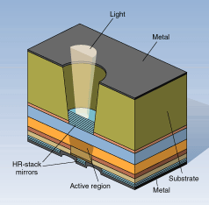
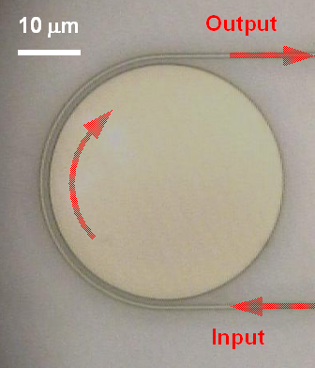
Optical coupling to cavity modes
Coupling approaches
  Free space coupling: F-P cavity
  Waveguide/fiber coupling: traveling wave cavities, PhC cavities
    Phase matching condition: efficient coupling
External Q-factor
  Energy loss due
  to coupling: Q_{ex}
  Extinction ratio
  depends on coupling
    Critical coupling
Opt. Lett. 33, 2500 (2008)

Slide 19
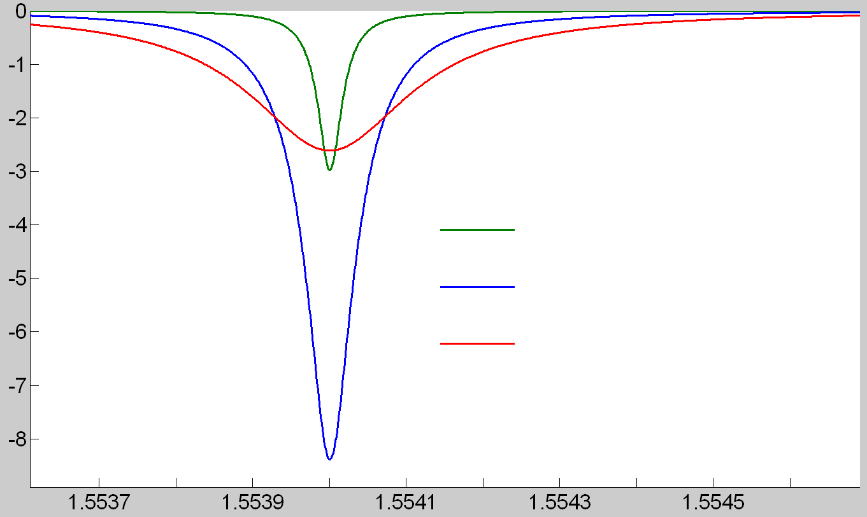
Optical coupling to cavity modes
Coupling approaches
  Free space coupling: F-P cavity
  Waveguide/fiber coupling: traveling wave cavities, PhC cavities
    Phase matching condition: efficient coupling
External Q-factor
  Energy loss due
  to coupling: Q_{ex}
  Extinction ratio
  depends on coupling
    Critical coupling
Transmission (dB)
Increase coupling strength
Wavelength (μm)

Slide 20
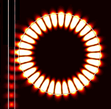
Critical coupling
through = 0
Critical coupling
Complete power transfer: transmittance T = 0
Maximum field enhancement inside the resonator
Occurs when Q_{ex} = Q_{in}
Under coupling
Q_{ex} > Q_{in}
Over coupling
Q_{ex} < Q_{in}
input

Slide 21
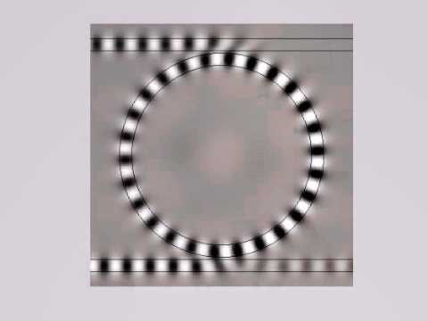
Critical coupling as a consequence of interference

Slide 22
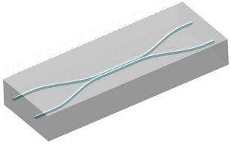
Matrix representation of directional couplers
b₁
b₂
a₂
b₂
Lossless coupler
a₁
b₁
a₁
a₂
Linear, lossless, uni-directional, reciprocal, single-mode couplers
where
Matrix K₁
Matrix K₂
Matrix K_{n}
a₁
…
b₁
Cascadability:
Coupler1
Coupler2
Coupler n
a₂
b₂
Ch. 4, Photonics: Optical Electronics in Modern Communications, A. Yariv and P. Yeh

Slide 23
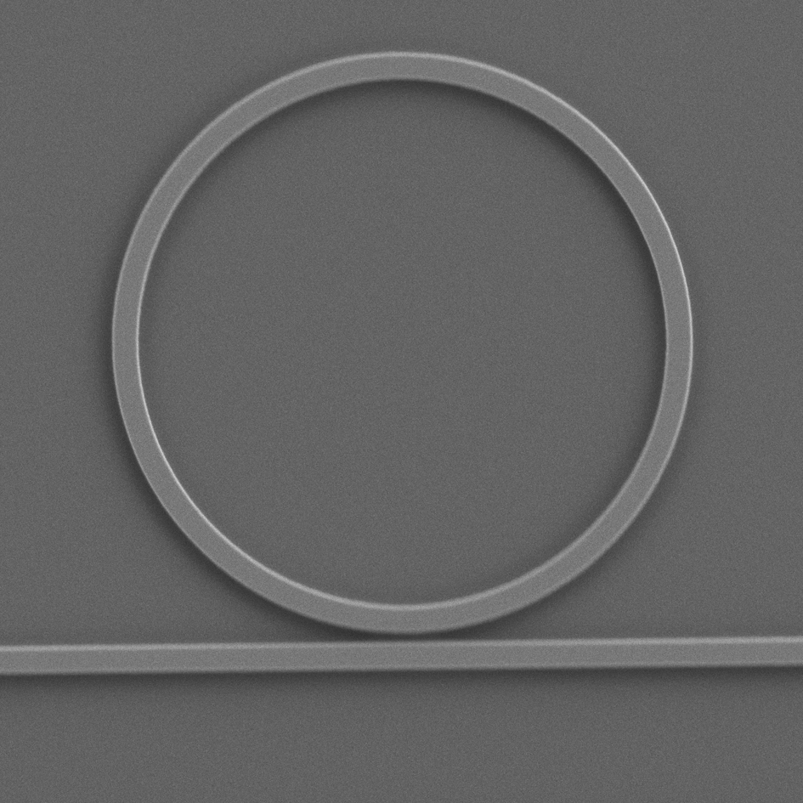
Coupling matrix approach for travelling wave cavities
a₂
b₂
Lossless
coupler
5 μm
a₁
b₁
α : waveguide loss; β : propagation constant; L : round-trip length
where
A. Yariv, Electron. Lett. 36, 321-322 (2000).

Slide 24
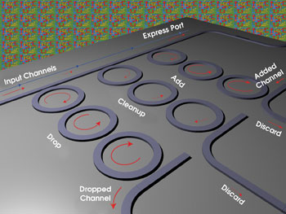
Coupling matrix approach for travelling wave cavities
a₁₅
a₁₆
3rd order add-drop filters
Coupler
4
a₁₃
a₁₄
L₆, α₆
L₅, α₅
a₁₁
a₁₂
Coupler
3
a₉
a₁₀
L₄, α₄
L₃, α₃
a₇
a₈
Coupled resonator steady state solution:
2 equations for each coupler: 8 total
1 equation for each ring section: 6 total
2 known inputs: a₁, a₁₆
Compile the equation coefficients into a 14-by-14 matrix
Solve the set of linear equations
Coupler
2
a₅
a₆
L₂, α₂
L₁, α₁
a₃
a₄
Coupler
1
a₁
a₂
The algorithm can be automated to solve coupled cavities of arbitrary topology

Slide 25
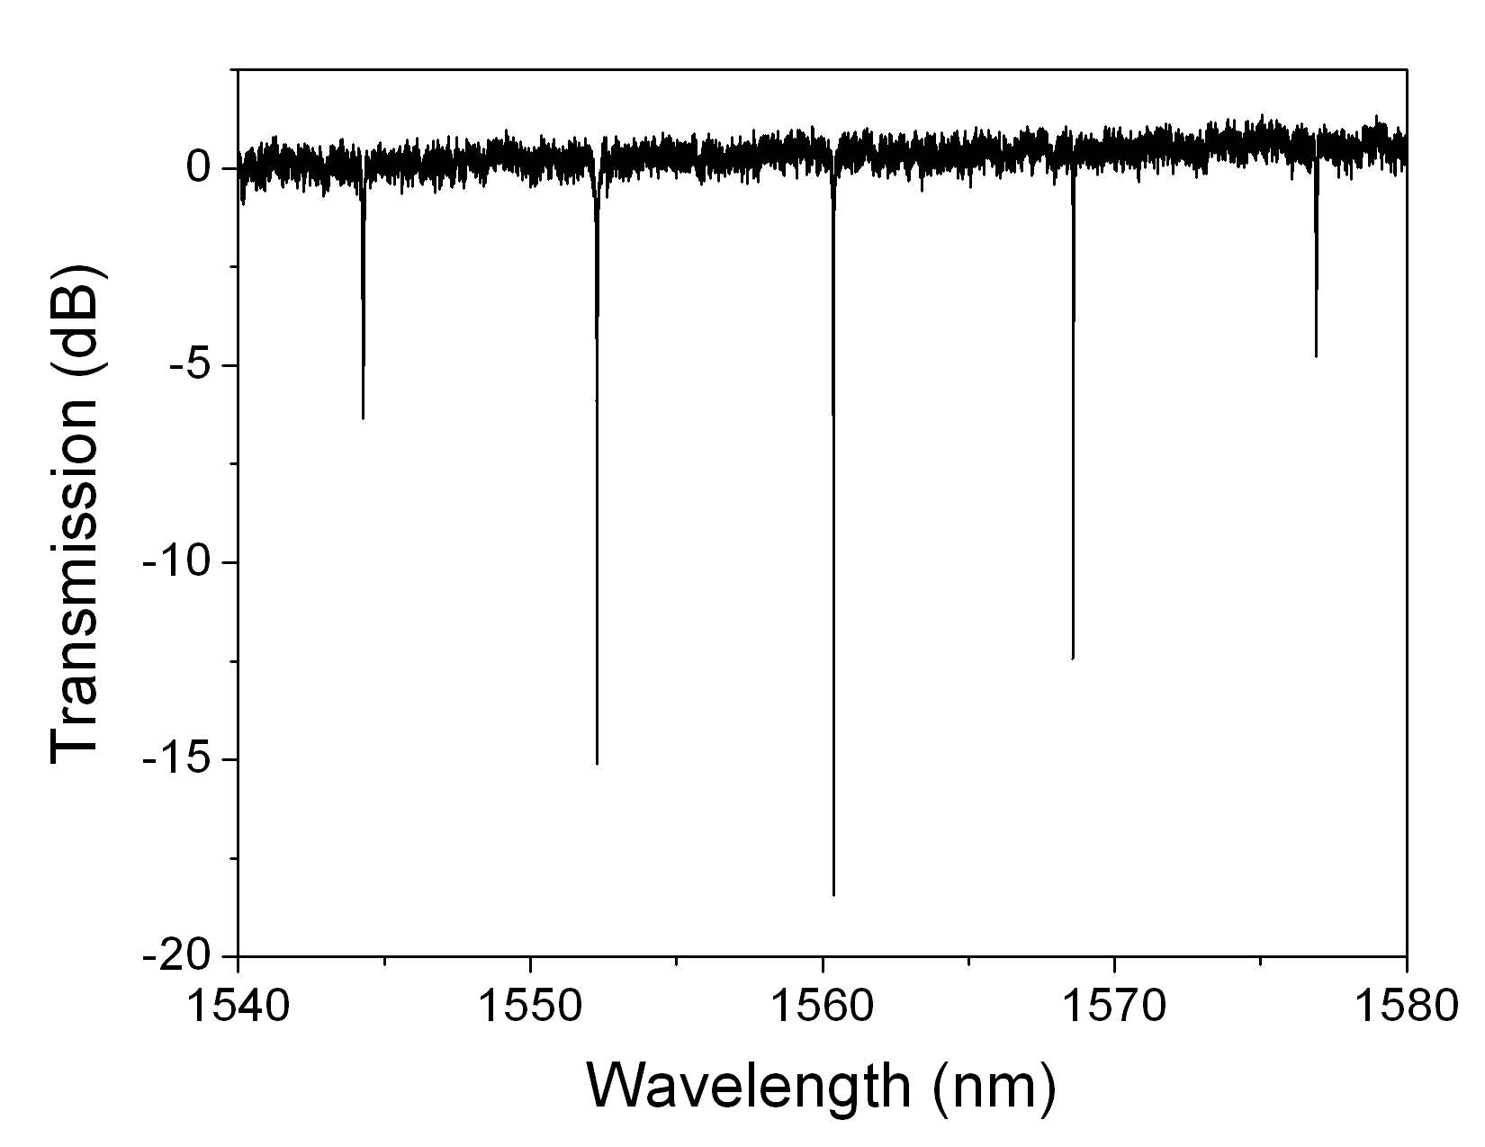
Waveguide loss measurement
Cut-back
Camera imaging
Ring resonator
Fabry-Perot
Under coupling
Over coupling
Loaded Q-factor at critical coupling:
Determining the coupling regime
Group index:
Variations of resonator Q among different azimuthal orders:
Opt. Lett. 37, 1586-1588 (2012)
* More generally, loss can be inferred from Q and extinction ratio even for non-critically-coupled rings: Matlab code for loss extraction

Slide 26
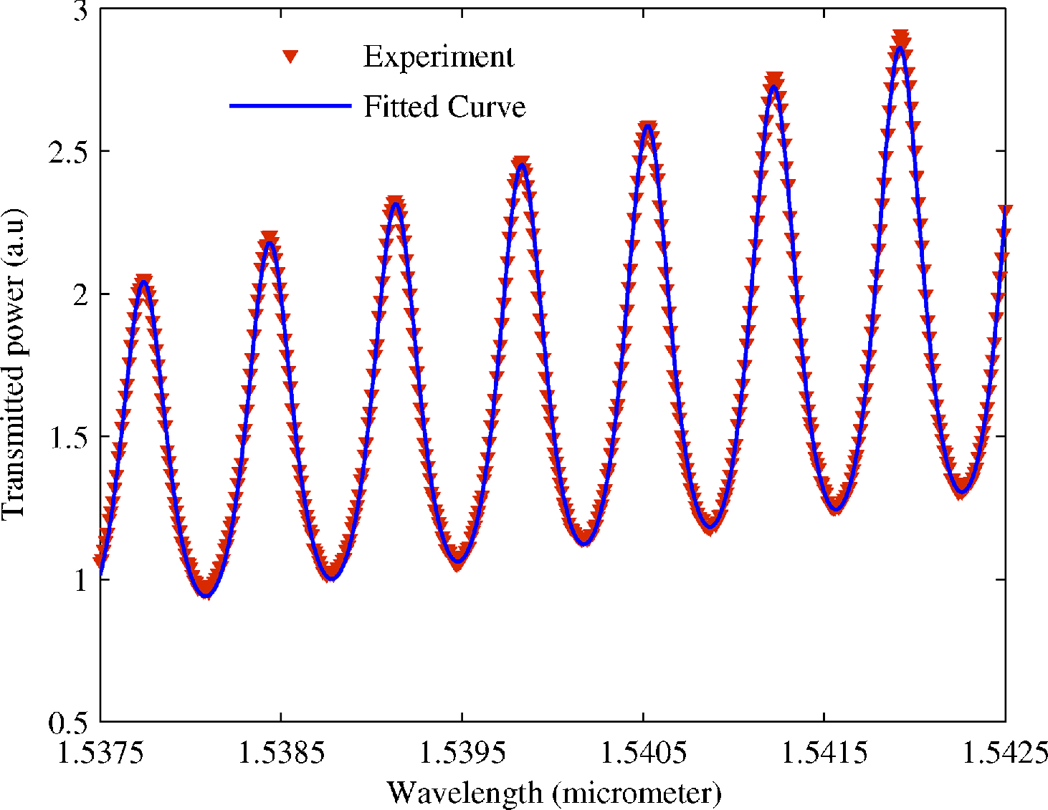
Waveguide loss measurement
Cut-back
Camera imaging
Ring resonator
Fabry-Perot
Accurate determination of facet reflectance is the key
IEEE PTL 6, 1244-1247 (1994)
Appl. Opt. 47, 6625-6630 (2008)
Opt. Express 27, 17876-17886 (2019)

Slide 27
Optical resonator: a ubiquitous platform
Selective spectral transmission/reflection
  Optical filters for WDM
Coherent optical feedback
  Lasers
Increased optical path (interaction) length
  Spectroscopy and sensing
  Modulators and switches
  Slow light: coupled resonator optical waveguide (CROW)
  Cavity-enhanced photodetector
Enhanced field amplitude (photon LDOS)
  Nonlinear optics
  Cavity quantum-electrodynamics (QED)
  Cavity optomechanics

Slide 28
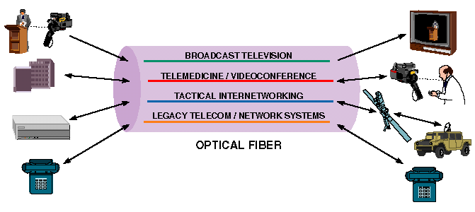
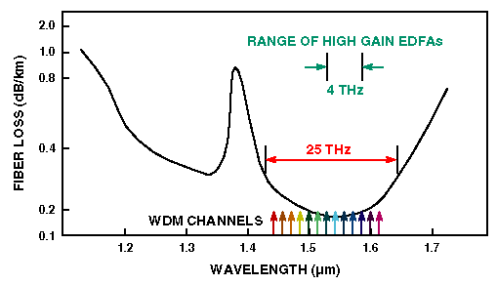
Wavelength Division Multiplexing (WDM)
Better use of existing fiber bandwidth
Little cross-talk between channels
Transparent to data format and rate
Mature technology

Slide 29
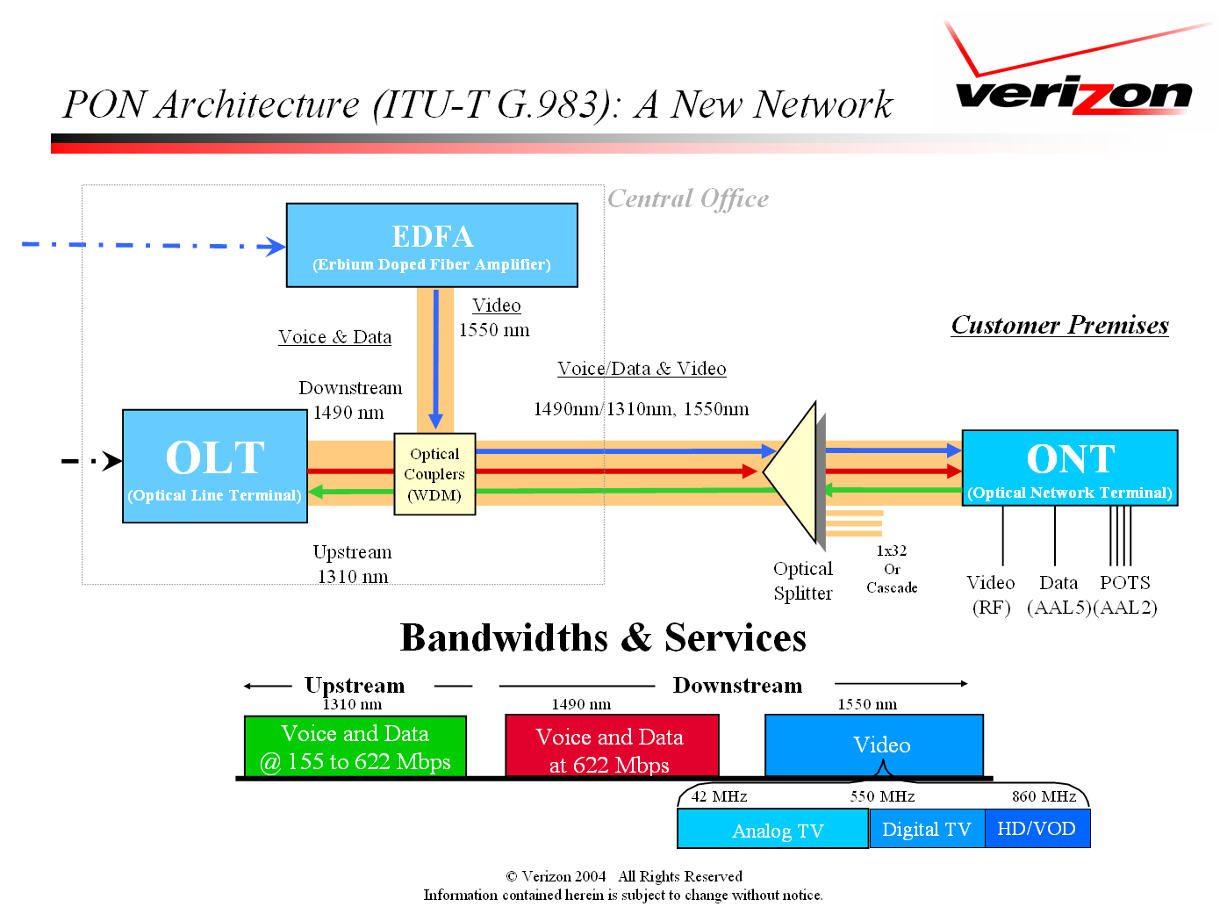
See what the “FiOS boy” says about WDM!

Slide 30
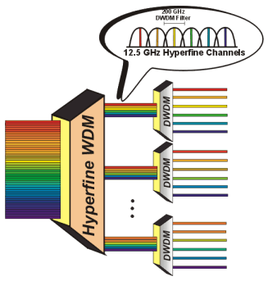
Wavelength Division Multiplexing (WDM)
Multiplexing
Better use of existing fiber bandwidth
Little cross-talk between channels
Transparent to data format and rate
Mature technology
De-multiplexing
λ₁ λ₂ λ₃ …

Slide 31
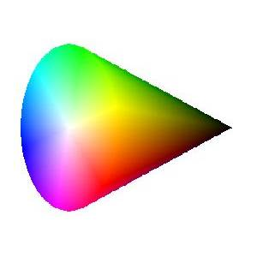
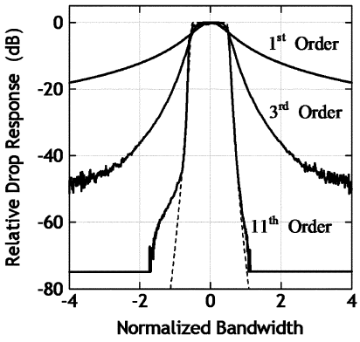
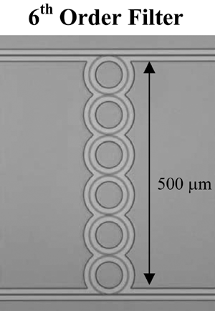
Ring resonator add-drop filter
λ₁
λ₂
λ_{n}
B. Little et al., J. Lightwave Technol. 15, 998 (1997).
B. Little et al., IEEE PTL 16, 2263 (2004).
T. Barwicz et al., JLT 24, 2207 (2006).
F. Xia et al., Opt. Express 15, 11934 (2007).
P. Dong et al., Opt. Express 18, 23784 (2010).
λ₁
λ₂
•
•
• λ_{n}
…
Add-drop filter design rules:
Low insertion loss: critical coupling, low WG loss
Low cross-talk:
large extinction ratio, FSR >> channel spacing
Flat response in the pass band

Slide 32
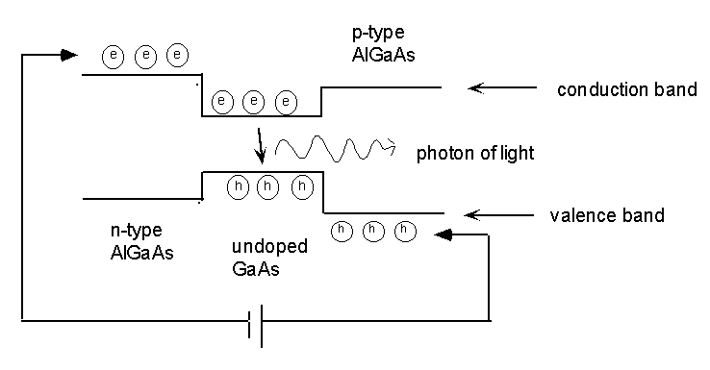
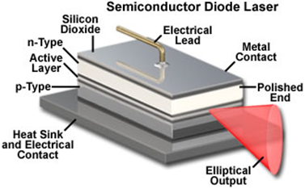
Semiconductor lasers
AlGaAs-GaAs-AlGaAs double heterojunction lasers
-
n-type AlGaAs
GaAs
p-type AlGaAs
Laser output
+
mirror
mirror
Edge-emitting laser

Slide 33
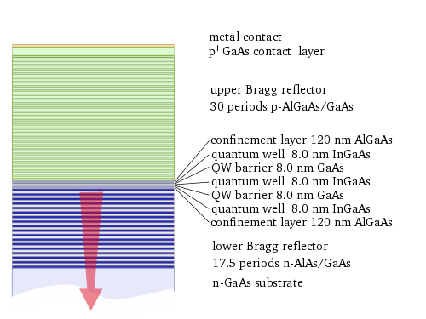

Vertical Cavity Surface Emitting Lasers (VCSELs)
On-wafer testing
Single longitudinal mode operation
Low threshold current
Long lifetime
http://www.rp-photonics.com/vertical_cavity_surface_emitting_lasers.html

Slide 34


Vertical Cavity Surface Emitting Lasers (VCSELs)
← VCSEL
← VCSEL
← VCSEL

Slide 35
Resonator optical sensors: refractometry
Species
Y Y Y Y Y Y Y Y Y Y
Surface functionalization coating selectively binding to the target species
The effective index change due to specific surface binding is used to detect target species
Refractometry relies on surface coatings to provide specificity

Slide 36
Resonator optical sensors: refractometry
Resonator
Resonant condition:
Light into waveguide

Slide 37
Resonator optical sensors: refractometry
Resonator
Resonant condition:
Light into waveguide
Resonance shift:
Using resonance shift to detect molecular binding

Slide 38
Resonator optical sensors: absorption spectrocopy
Resonator
Resonant condition:
Light into waveguide

Slide 39
Resonator optical sensors: absorption spectrocopy
Resonator
Effective optical path length:
Light into waveguide
Using extinction ratio change to detect optical absorption caused by target molecules

Slide 40



Resonator optical sensors: refractometry
Low-cost, single-use passive photonic sensor chips with limit of detection down to < 10⁻⁶ RIU
Highly multiplexed analysis
On-chip reference resonators to calibrate temperature fluctuations
IEEE J. Sel. Top. Quantum Electron. 16, 654 (2010)
Maverick Detection System © Genalyte

Slide 41


Silicon micro-ring switch/modulator
Refractive index change in silicon via free carrier dispersion effect: optical/electrical carrier injection
Low power consumption due to small footprint
V. Almeida et al., “All-optical control of light on a silicon chip,” Nature 431, 1081 (2004).
Q. Xu et al., “Micrometer-scale silicon electro-optic modulator,” Nature, 435, 325 (2005).

Slide 42



The challenge: narrow band operation & fabrication/thermal sensitivity
2000 GHz
Q = 1,000
Si waveguide cross-section 450 nm × 200 nm

Slide 43

Active thermo-optic compensation
Use transmittance variation from the resonator to perform feedback control on integrated heaters
Nanophotonics 3, 269 (2014)

Slide 44

Towards electronic-photonic convergence
Nature 528, 534-538 (2015)

Slide 45

Resources: VM-Lab Simulations
Ring resonators: add-drop configuration
  Wavelength
  Resonator size
  Coupling gap
Ring resonators: all-pass configuration

Slide 46
List of symbols
a / b – field amplitude
t₁ / r₁ – amplitude transmission / reflection coefficient of mirror or coupler 1
k – wave vector of light in the cavity
r – round-trip amplitude transmission coefficient
T – transmittance (measured with intensity)
Q – quality factor, Q-factor
F – finesse
FSR – free spectral range
Δω – full width at half maximum of resonant peak measured with angular frequency

Slide 47
List of symbols
ω₀ – angular frequency of light at resonance
λ₀ – resonant wavelength
L – cavity length
c – speed of light
W – energy stored in resonator
P_{loss} – energy loss rate (in J/s or W) of resonator
Δλ – full width at half maximum of resonant peak measured in the wavelength domain
n_{g} – group index
c₀ – speed of light in vacuum (2.99792458 × 10⁸ m/s)

Slide 48
List of symbols
ε – permittivity
E – electric field
– position vector
Q_{ex} – extrinsic quality factor, quality factor calculated from energy loss rate due to coupling to resonator
Q_{in} – intrinsic quality factor, quality factor calculated from energy loss rate due to optical loss inside resonator
Q_{tot} – loaded quality factor, which accounts for both coupling and intrinsic losses
κ – (amplitude) cross coupling coefficient of resonator coupler

Slide 49
List of symbols
α – waveguide loss
β – propagation constant
Q_{cr} – loaded quality factor at critical coupling
n_{eff} – effective index
N – longitudinal modal index (a positive integer)
δλ – resonant wavelength shift due to effective index change

